Slide 1




Electromagnetic radiation from Au+Au collisions at $\sqrt{\text{s}\text{NN}}$ = 2.4 GeV measured with HADES
Dominique Dittert for the HADES Collaboration
Outline
Introduction
Differential Spectra
Azimuthal Anisotropy
Recent Ag+Ag Beamtime
Summary

Slide 2
Introduction

Slide 3
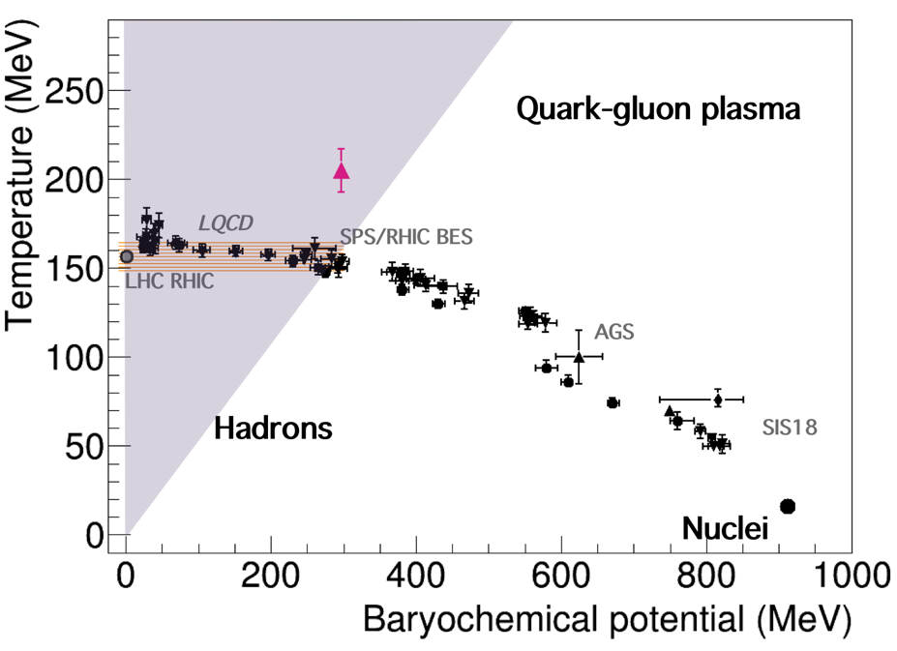
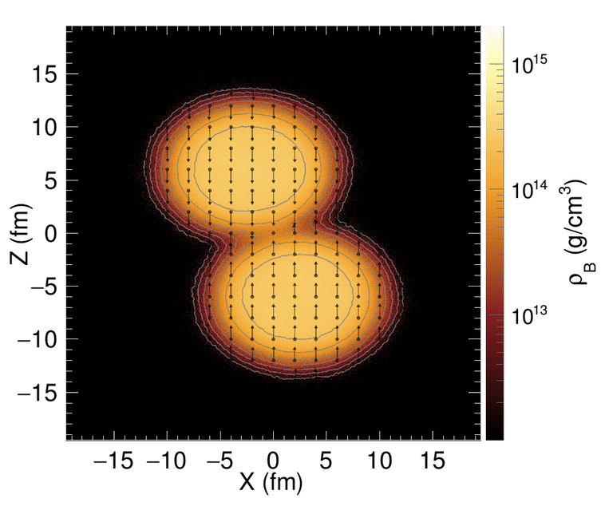
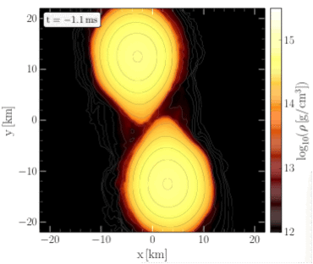
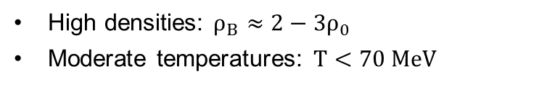
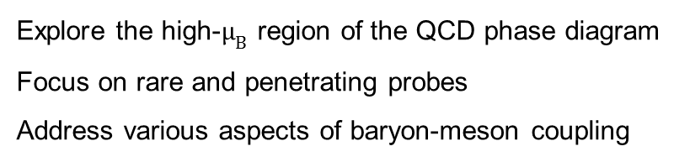
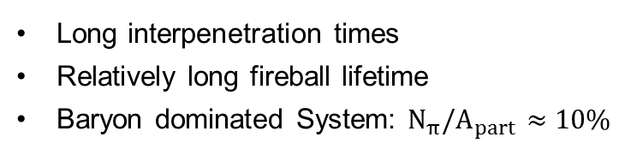

The HADES Physics Case
Pion- and Nucleon-Beams:
Reference measurements (vacuum, cold QCD matter)
Electromagnetic structure of baryons and hyperons in the region of 0 < q² < 4m_{p}²
Heavy-Ion-Collisions:
Properties of matter similar to neutron star mergers
Explore the high-$μ_{B}$ region of the QCD phase diagram
Focus on rare and penetrating probes
Address various aspects of baryon-meson coupling
Au+Au, $\sqrt{s_{NN}}=2.4$ GeV
NS mergers
HADES
Long interpenetration times
Relatively long fireball lifetime
Baryon dominated System: $N_{π}/A_{part}≈10\%$
[Fig. credit: T. Galatyuk, M. Hanauske, F. Seck]
High densities: $ρ_{B}≈{2−3ρ}_{0}$
Moderate temperatures: $T<70 MeV$

Slide 4
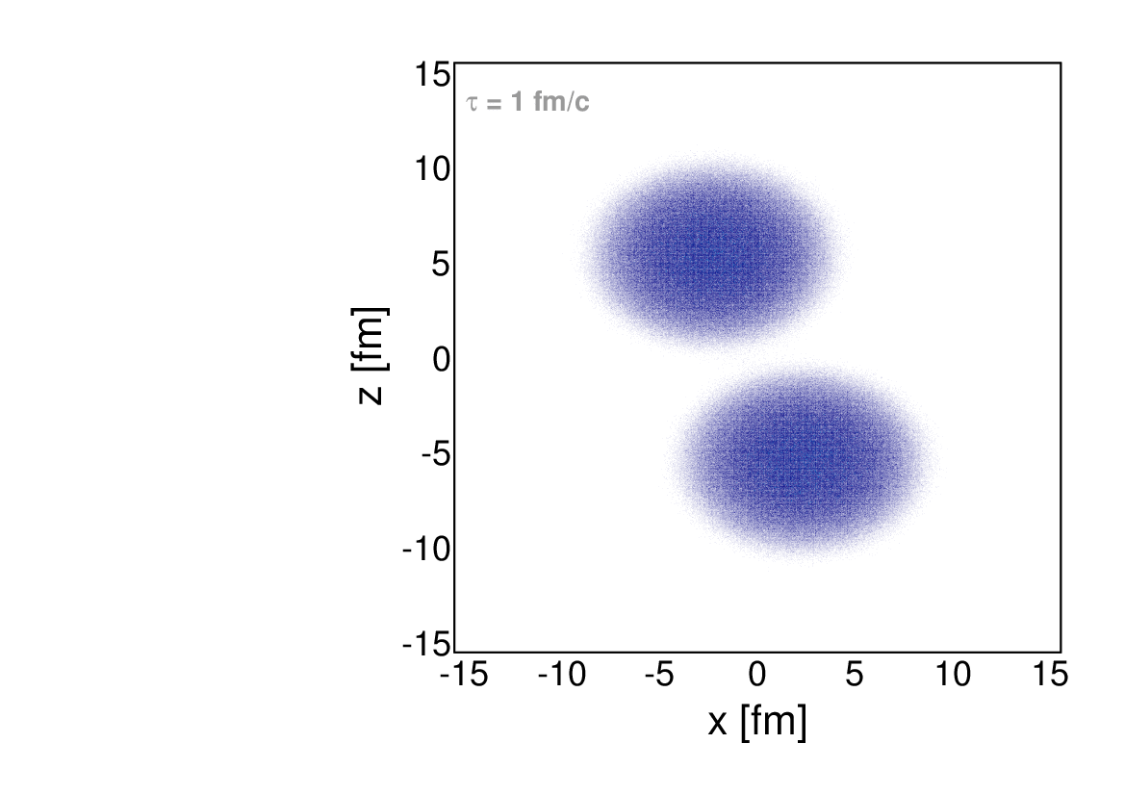
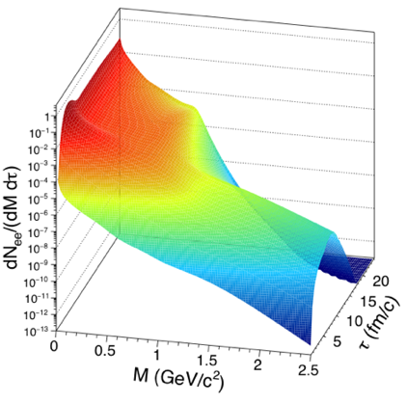
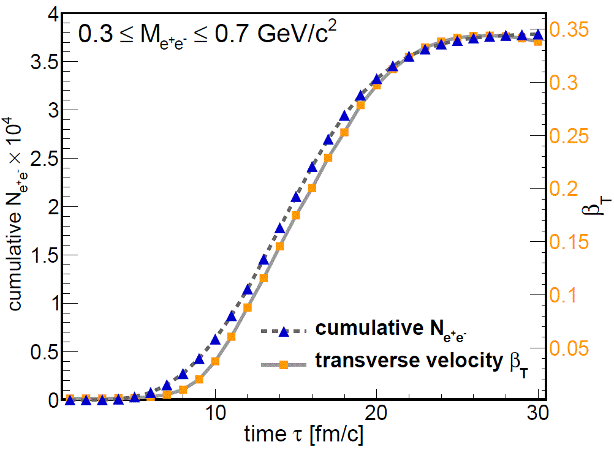
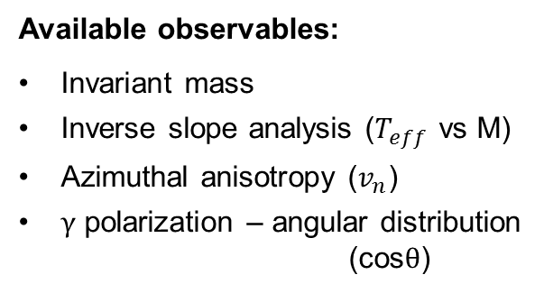
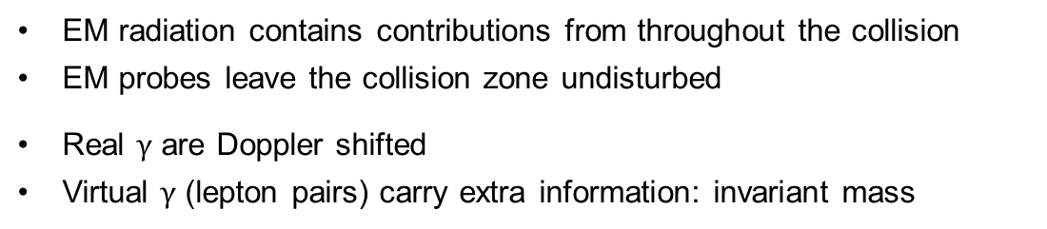
Electromagnetic radiation from the fireball
Space-time evolution
EM radiation contains contributions from throughout the collision
EM probes leave the collision zone undisturbed
Real $γ$ are Doppler shifted
Virtual $γ$ (lepton pairs) carry extra information: invariant mass
γ
γ∗
l⁺
l⁻
In medium ρ and ω SF
& QGP rates vs. time
Available observables:
Invariant mass
Inverse slope analysis ($T_{eff}$ vs M)
Azimuthal anisotropy ($v_{n}$)
$γ$ polarization – angular distribution
(cos$θ$)
In-medium
spectral fct.
Collectivity
Source of
Radiation

Slide 5
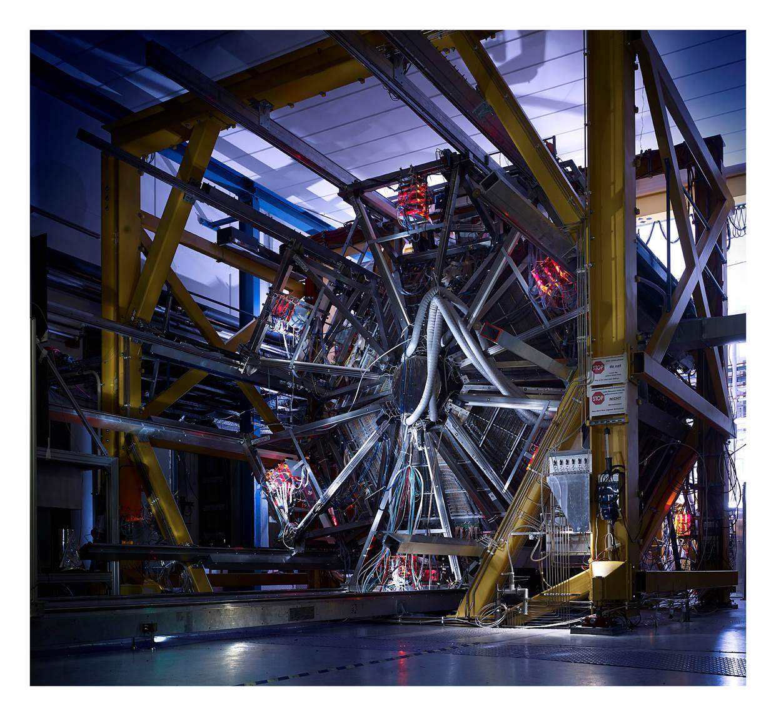
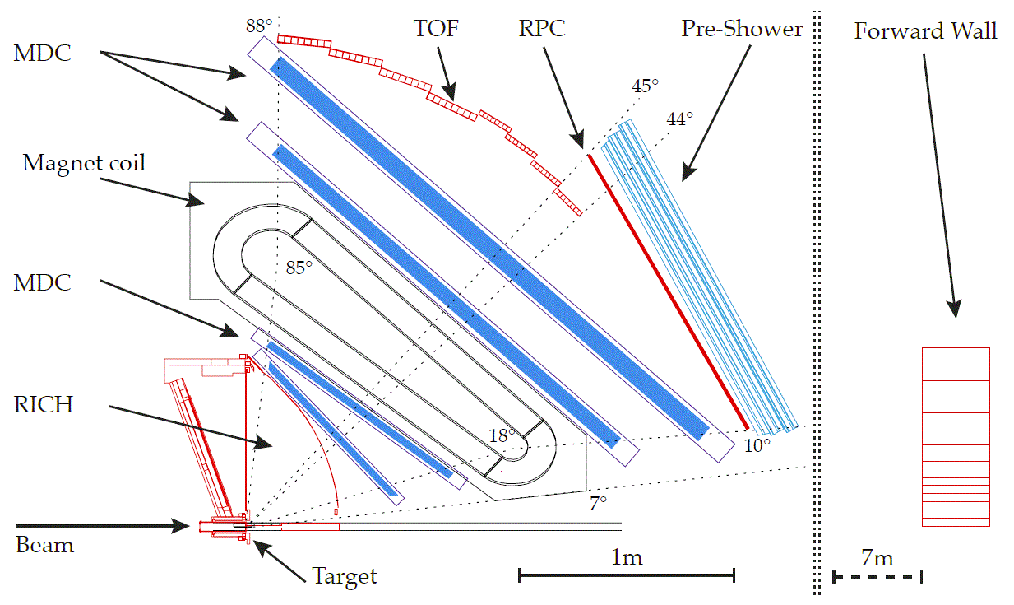
High-Acceptance Di-Electron Spectrometer
Photo: Jan Michael Hosan/HA Hessen Agentur GmbH
Fast detector → interaction rate: 8 kHz in Au+Au, 200 kHz at SIS100
Large acceptance → full azimuthal coverage, polar angles from 18º to 85º
Mass resolution → of the order of few %
Good particle identification
Efficient track reconstruction
Particle
Identification
Particle tracks
and momenta
Event plane
reconstruction

Slide 6

Differential $e^{+}e^{−}$ Spectra

Slide 7
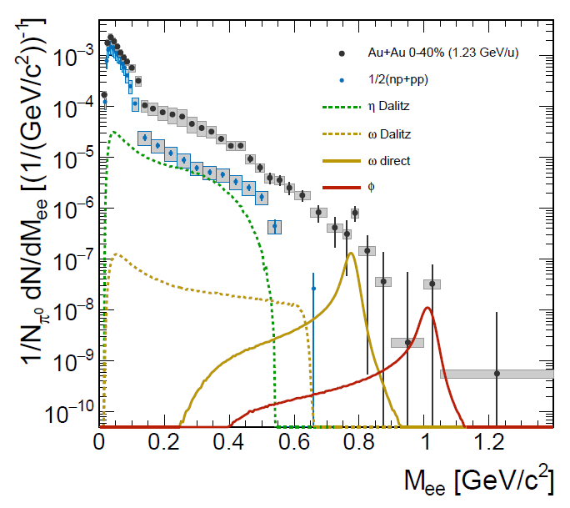
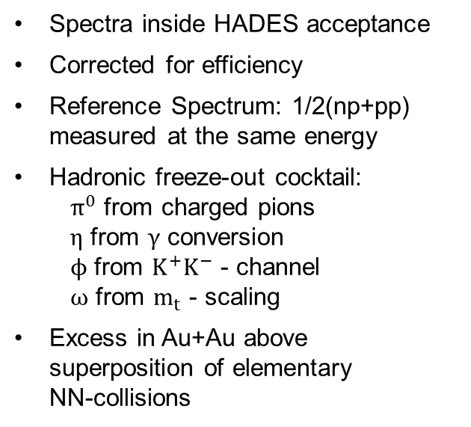
Dilepton Invariant Mass Spectrum
Spectra inside HADES acceptance
Corrected for efficiency
Reference Spectrum: 1/2(np+pp) measured at the same energy
Hadronic freeze-out cocktail:
  $π^{0}$ from charged pions
  $η$ from $γ$ conversion
  $ϕ$ from $K^{+}K^{−}$ - channel
  $ω$ from $m_{t}$ - scaling
Excess in Au+Au above superposition of elementary
NN-collisions

Slide 8
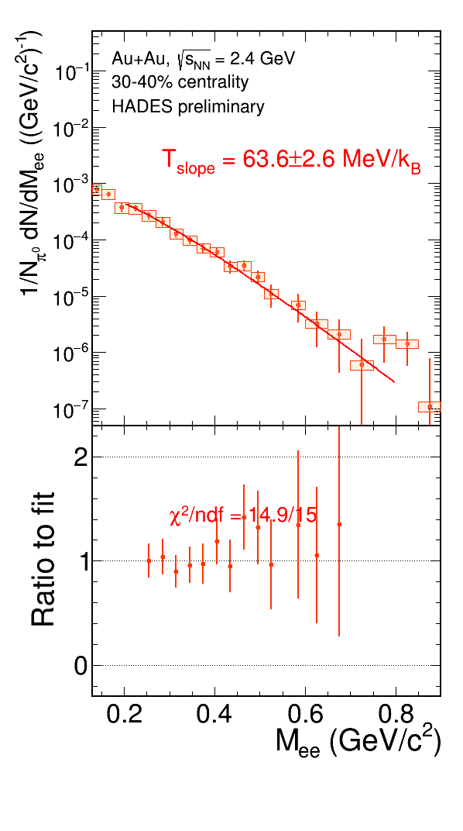
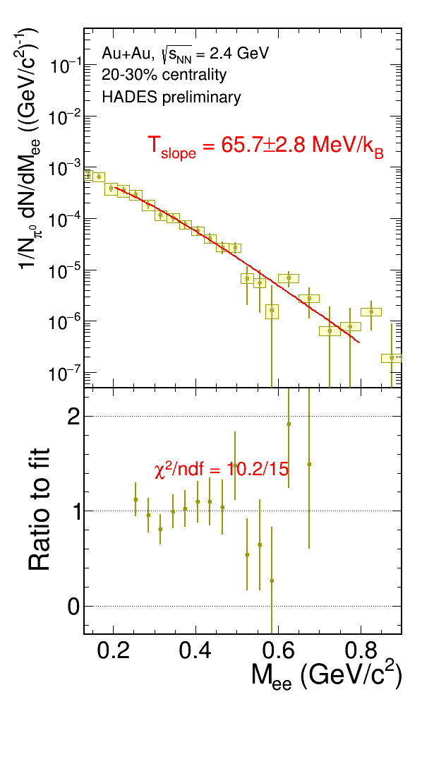
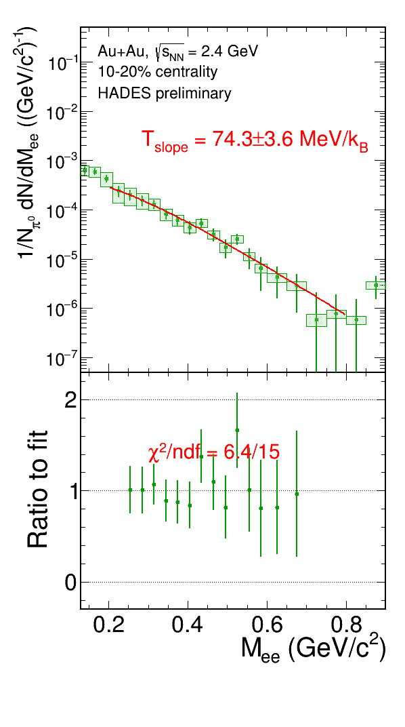
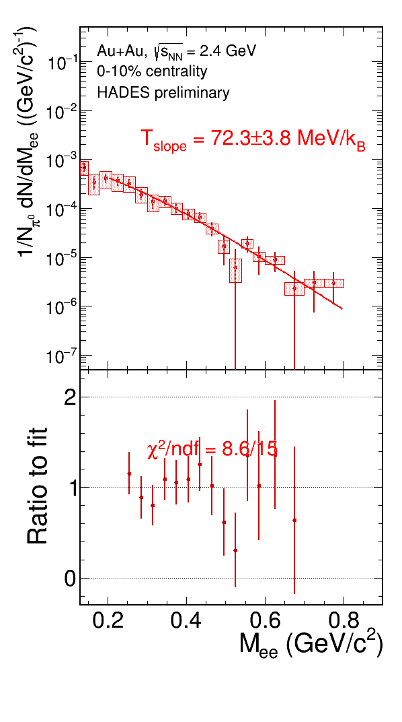
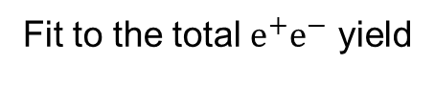
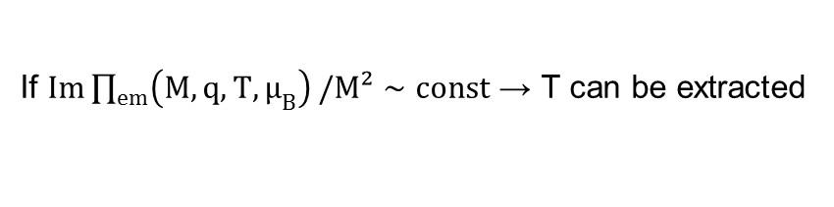
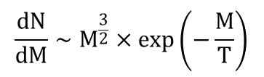
Centrality dependent Invariant Mass Spectra
Fit to the total $e^{+}e^{−}$ yield
(McLerran - Toimela formula, Phys. Rev. D 31 (1985) 545)
$$\frac{dN}{dM}∼M^{\frac{3}{2}}×exp\left(−\frac{M}{T}\right)$$
If $Im\prod_{em}^{ }{\left(M,q,T,μ_{B}\right)}/M²∼const$ → T can be extracted

Slide 9
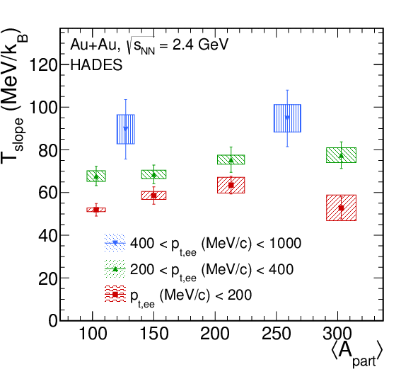
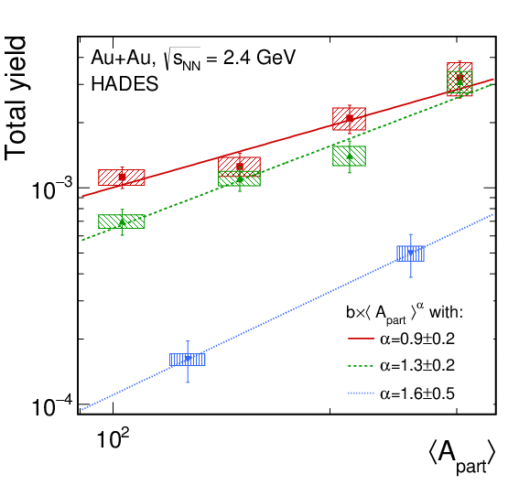

Inverse Slope Analysis
$A_{part}$-dependent
p_{t}-dependent
preliminary
preliminary
Comparison CG?
→ Hotter source of radiation in more
central collisions
Interesting behaviour
→ Models are needed
→ Hotter source of radiation at higher p_{t}

Slide 10
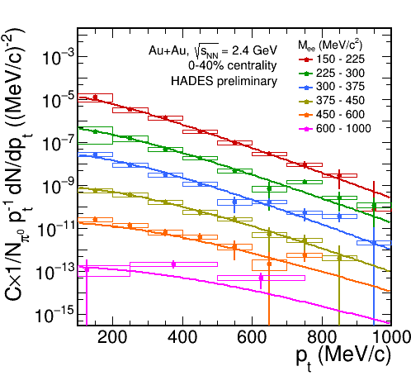
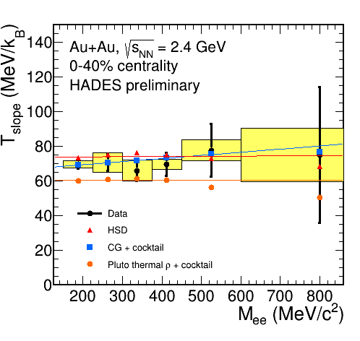
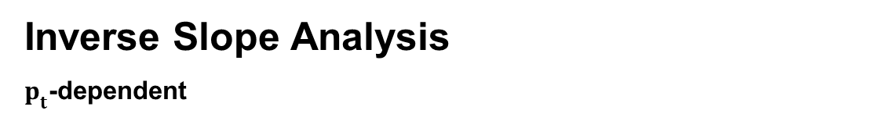
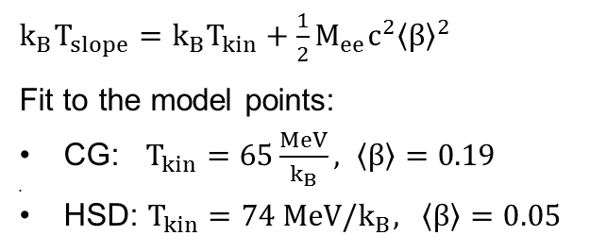
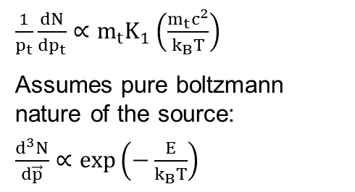
Inverse Slope Analysis
$p_{t}$-dependent
$\frac{1}{p_{t}}\frac{dN}{dp_{t}}∝m_{t}K_{1}\left(\frac{m_{t}c^{2}}{k_{B}T}\right)$
Assumes pure boltzmann nature of the source:
$\frac{d^{3}N}{d\vec{p}}∝exp\left(−\frac{E}{k_{B}T}\right)$
$k_{B}T_{slope}=k_{B}T_{kin}+\frac{1}{2}M_{ee}c^{2}{\left\langle β\right\rangle }^{2}$
Fit to the model points:
CG: $T_{kin}=65\frac{MeV}{k_{B}}, \left\langle β\right\rangle =0.19$
HSD: $T_{kin}=74 MeV/k_{B}, \left\langle β\right\rangle =0.05$

Slide 11
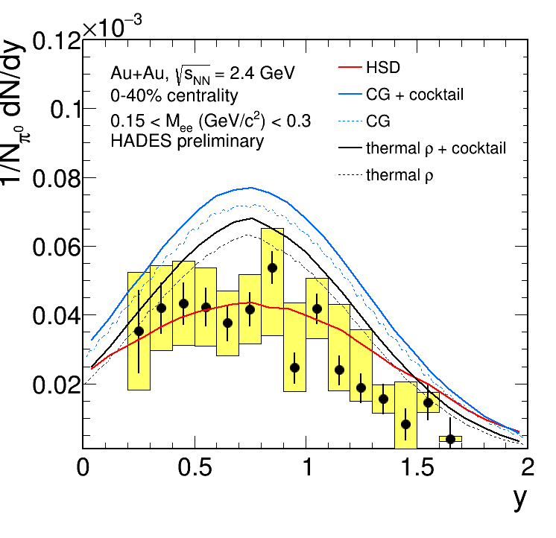
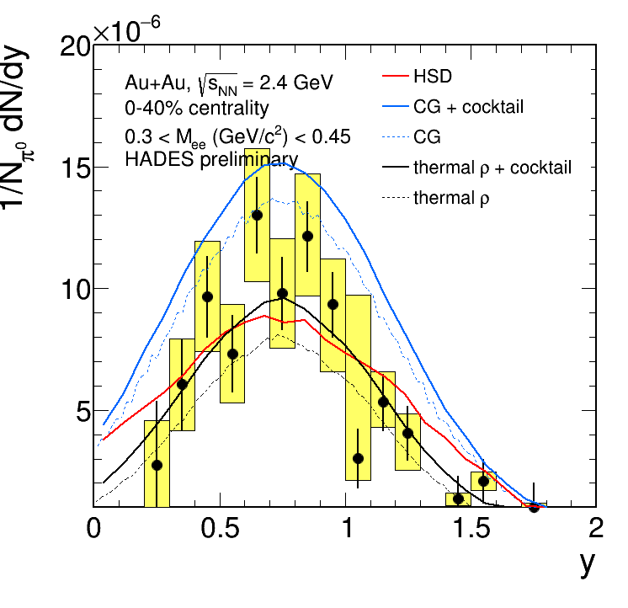
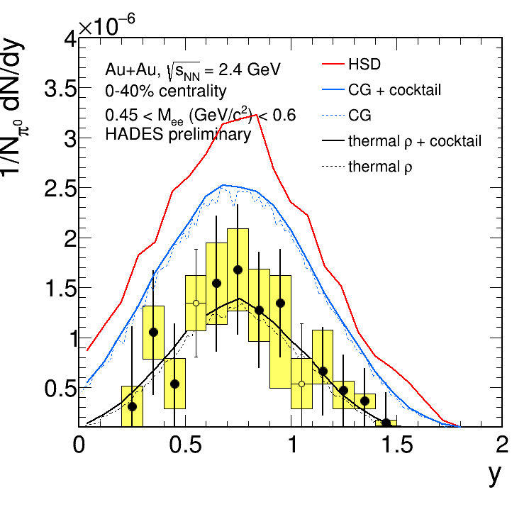
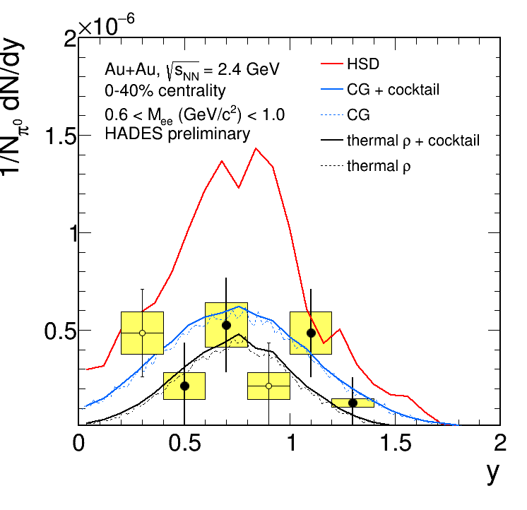
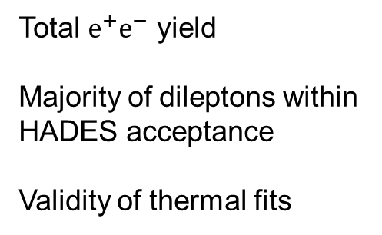
Rapidity dependent dilepton distributions
0.15 < M_{ee} [GeV/c²] < 0.3
0.3 < M_{ee} [GeV/c^{2]} < 0.45
Total $e^{+}e^{−}$ yield
Majority of dileptons within HADES acceptance
Validity of thermal fits
y_{CM} = 0.74
y_{CM}
0.45 < M_{ee} [GeV/c²] < 0.6
0.6 < M_{ee} [GeV/c²] < 1.0
y_{CM}
y_{CM}

Slide 12
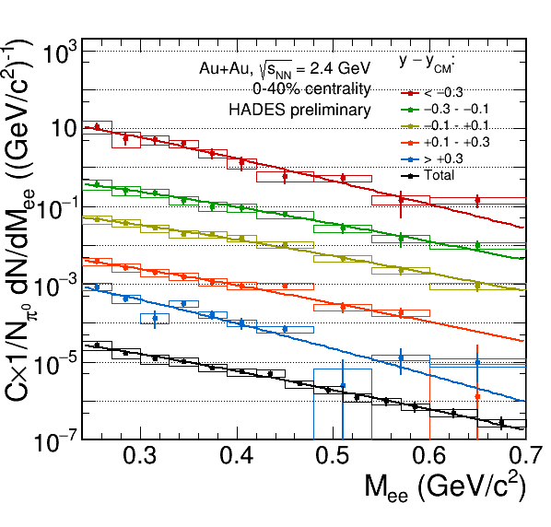
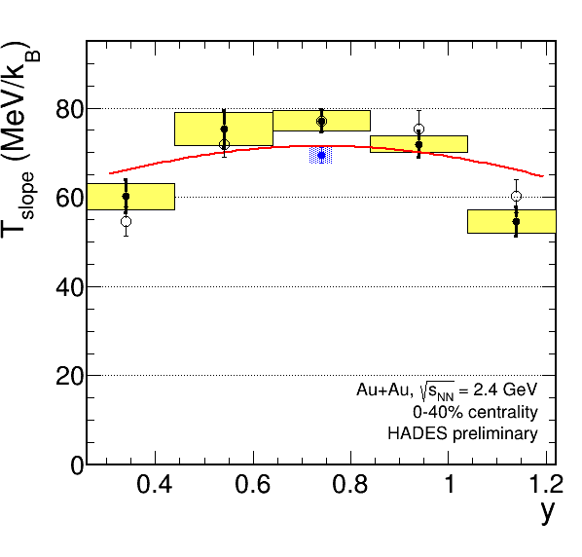
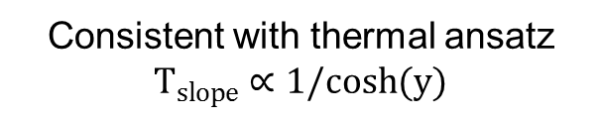
Inverse Slope Analysis y-dependent
Consistent with thermal ansatz
$T_{slope}∝1/cosh(y)$

Slide 13
Azimuthal Anisotropy

Slide 14
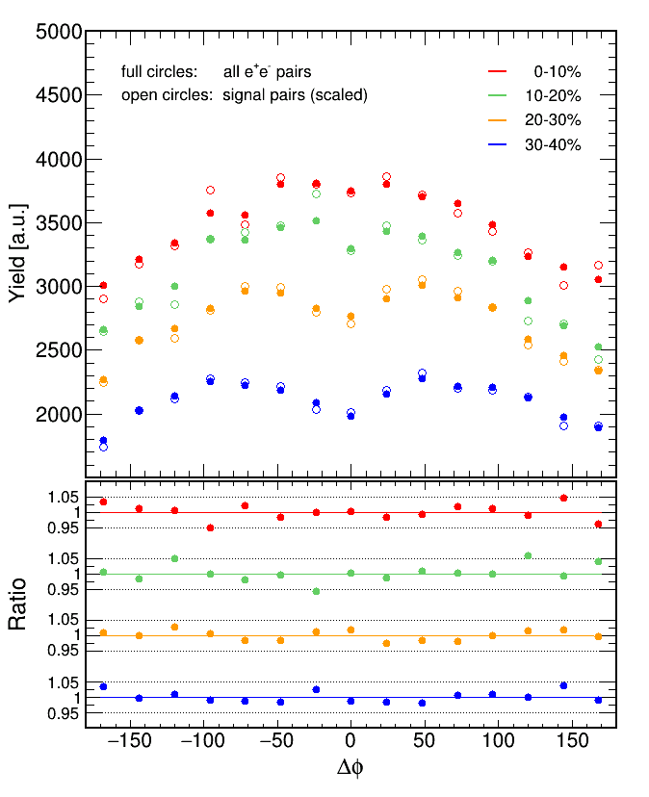
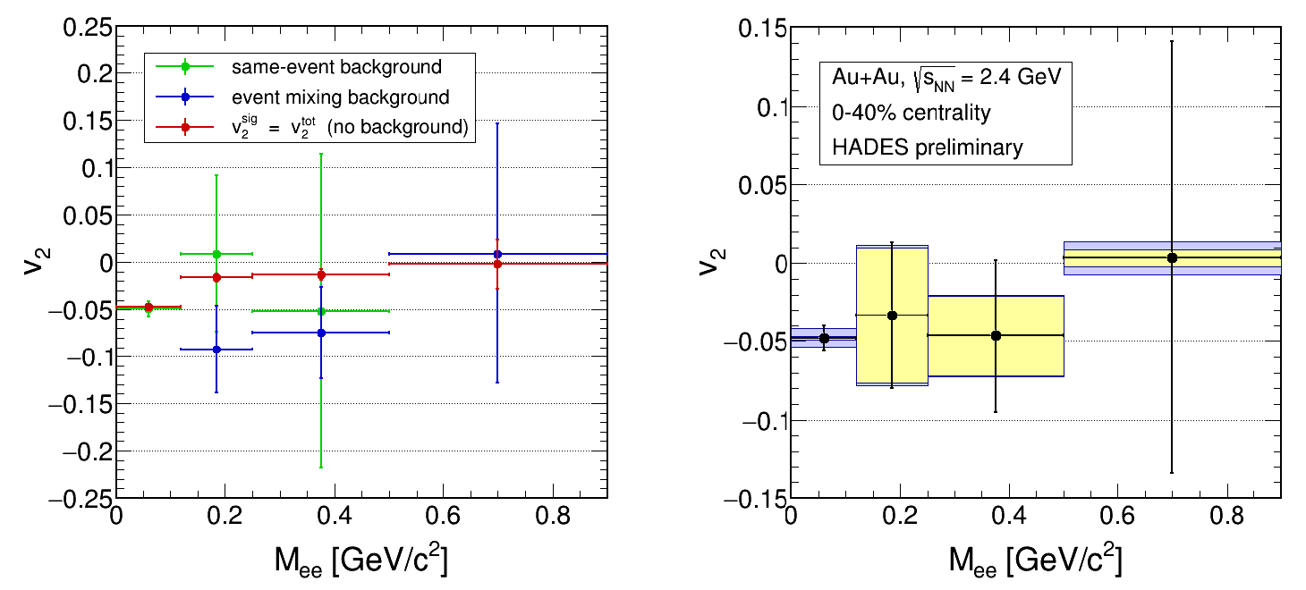

Invariant Mass dependent Azimuthal Anisotopy
HADES preliminary
Hypothesis: $v_{2}^{sig}=v_{2}^{tot}$

Slide 15
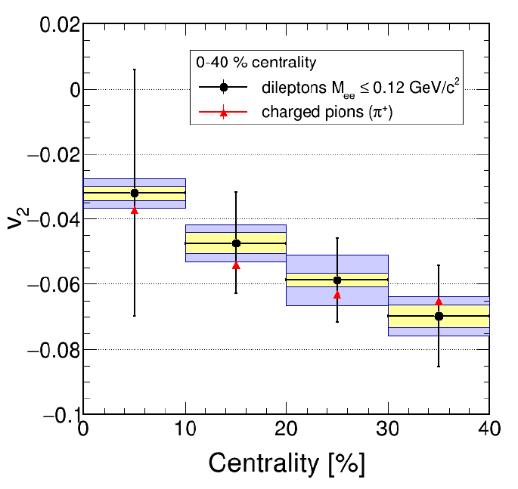
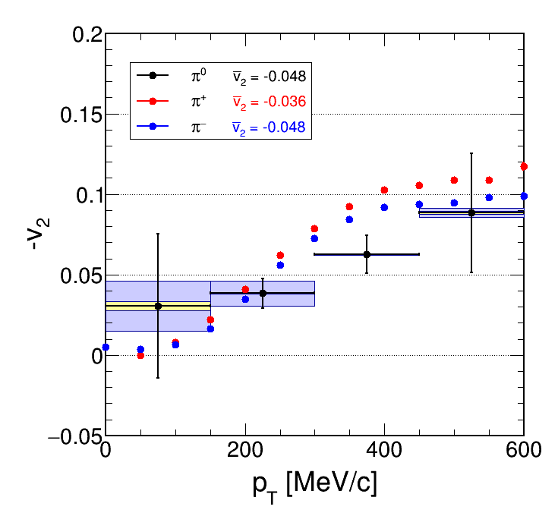

Azimuthal Anisotropy
Dileptons $M_{ee}≤0.12 GeV/c^{2}$
HADES preliminary
HADES preliminary

Slide 16
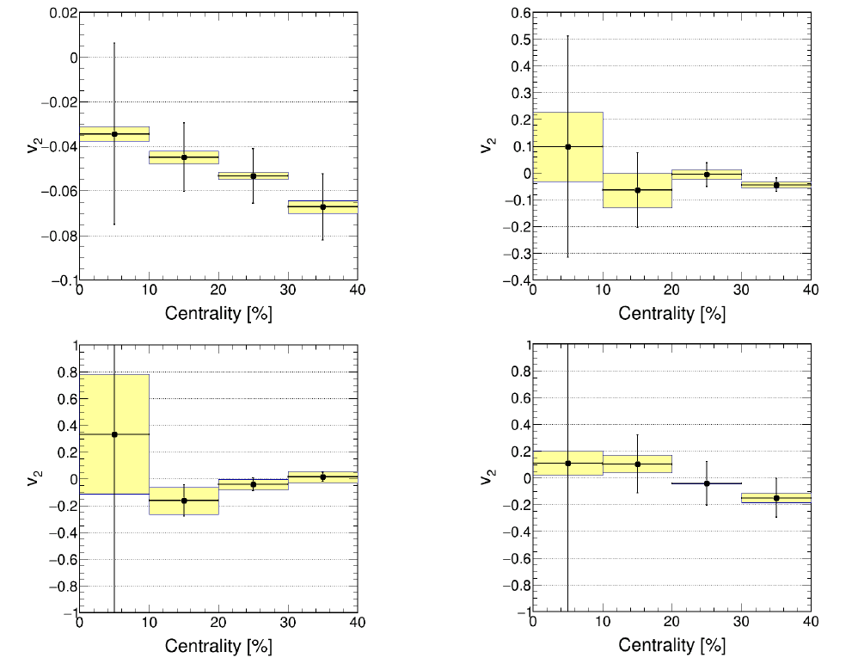

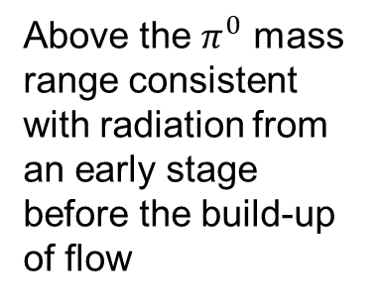



Azimuthal Anisotropy
Centrality-dependent
$$0<M_{ee}[ GeV/c^{2}]<0.12$$
$0.12<M_{ee}[ GeV/c^{2}]<0.$25
HADES preliminary
HADES preliminary
Above the $π^{0}$ mass range consistent with radiation from an early stage before the build-up of flow
$$0.25<M_{ee}[ GeV/c^{2}]<0.5$$
$$0.5<M_{ee}[ GeV/c^{2}]<0.9$$
HADES preliminary
HADES preliminary

Slide 17
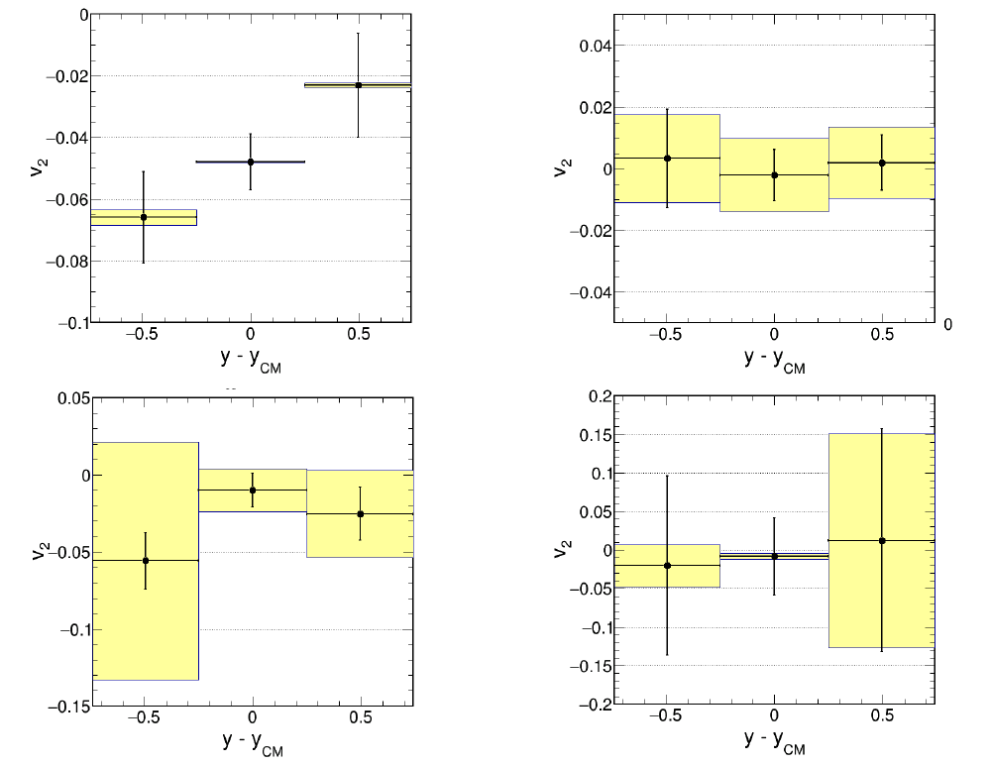


Azimuthal Anisotropy y-dependent
$$0<M_{ee}[ GeV/c^{2}]<0.12$$
$0.12<M_{ee}[ GeV/c^{2}]<0.$25
Above the $π^{0}$ mass range consistent with radiation from an early stage before the build-up of flow
HADES preliminary
HADES preliminary
$$0.25<M_{ee}[ GeV/c^{2}]<0.5$$
$$0.5<M_{ee}[ GeV/c^{2}]<0.9$$
HADES preliminary
HADES preliminary

Slide 18
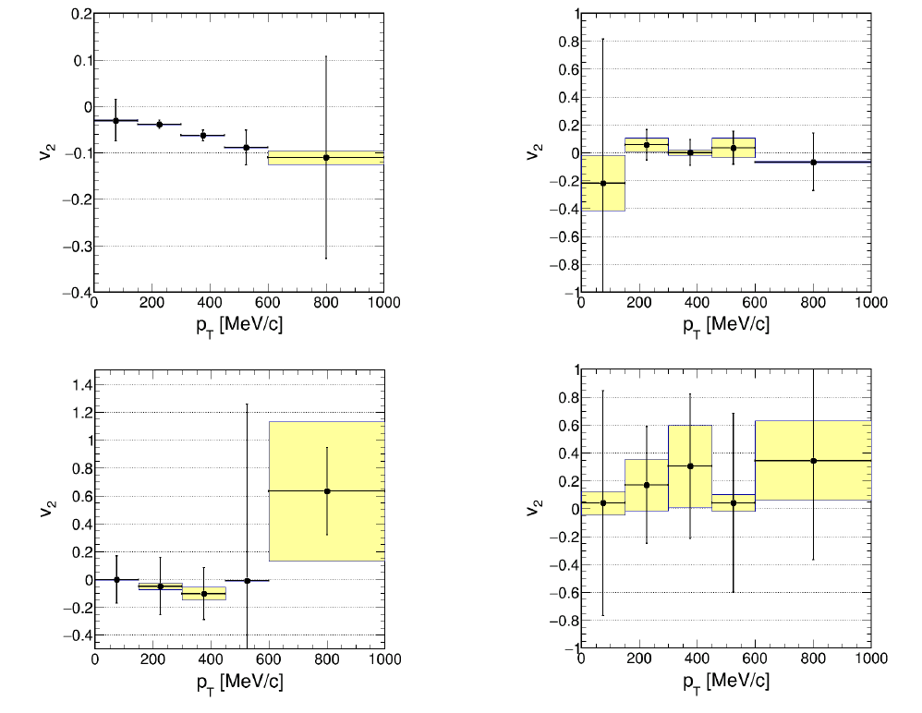
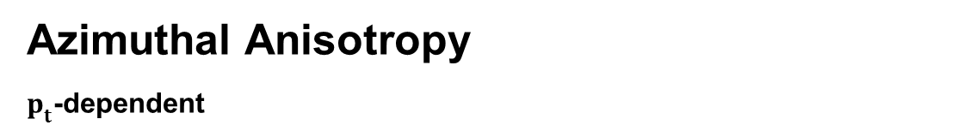
Azimuthal Anisotropy
$p_{t}$-dependent
$$0<M_{ee}[ GeV/c^{2}]<0.12$$
$0.12<M_{ee}[ GeV/c^{2}]<0.$25
Above the $π^{0}$ mass range consistent with radiation from an early stage before the build-up of flow
HADES preliminary
HADES preliminary
$$0.25<M_{ee}[ GeV/c^{2}]<0.5$$
$$0.5<M_{ee}[ GeV/c^{2}]<0.9$$
HADES
preliminary
HADES preliminary

Slide 19
Ag+Ag @ 1.58 A GeV

Slide 20
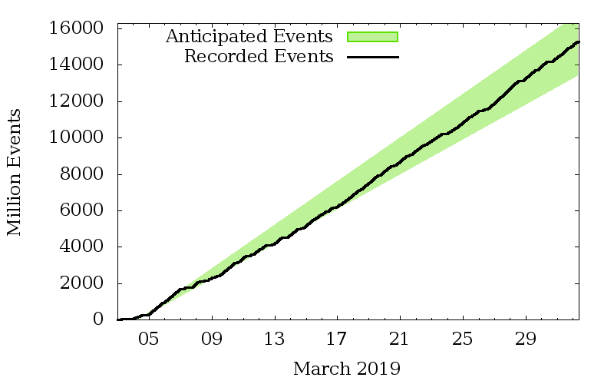
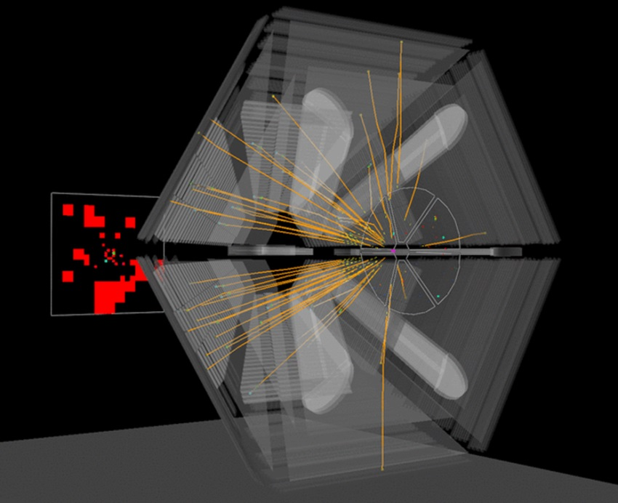
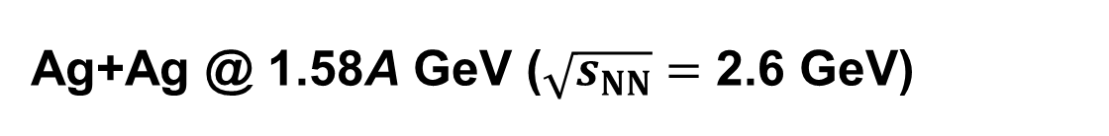
Ag+Ag @ 1.58A GeV ($\sqrt{s_{NN}}=$ 2.6 GeV)
FAIR Phase-0 Experiment
Event display
~ 15 billion events were collected during March 2019

Slide 21
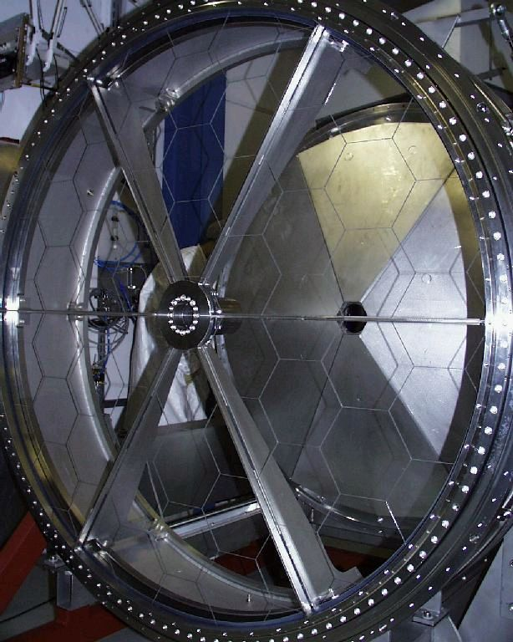

Refurbished RICH-Detector
Old MWPC photon detector
replaced by an array of PMTs
One can detect dileptons on an event display ☺

Slide 22






Lepton Identification
System 0:
θ < 45 deg
Timing with RPC
System 1:
θ > 45 deg
Timing with scintillator
Default track selection
and double hit rejection
Simple lepton PID
Almost no new calibrations yet
Very rough cuts
Still, it is possible to extract clean lepton sample

Slide 23



Dilepton Invariant Mass
HADES online
HADES online
HADES online
Asymmetry for reconstruction of like- and unlike-sign pairs
Very similar like in Au+Au, but far higher precision is possible
Signal-to-background ratio
much better than in Au+Au!

Slide 24

Summary
Conclusion
HADES explores baryon rich matter at SIS18 (GSI, Darmstadt, Germany)
Good agreement between experimental results and theory predictions
Invariant mass spectra less steep at higher $p_{t}$ and $A_{part}$
  → Hotter radiation source for higher $p_{t}$ and more central collisions
$T_{slope}$ does not scale with $M_{ee}$
Thermal dileptons do not show flow
Good agreement between flow of charged pions and dileptons from $π_{0}$-decays
preliminary
y_{CM}
Outlook
Analysis of more peripheral events
Analysis of the recent Ag+Ag beamtime

Slide 25
Thank you for your Attention

Slide 26
Backup

Slide 27









Lepton Identification
Particle Reconstruction
  Track Reconstruction: Hit positions in MDC planes
  Momentum Reconstruction: Deflection in the magnetic field
  META-Matching: Combining MDC tracks and time-of-flight information
  RICH Ring Reconstruction: Ring Finder Algorithm or Backtracking
Event Selection
  Sector Quality
  Centrality Selection
  Event Plane Reconstruction
Single Lepton Identification
  Multivariate Analysis using a Multi-Layer Perceptron

Slide 28






Dilepton Analysis
Combinatorial Background
Same-Event Like-Sign Geometric-Mean
Mixed-Event Background
Correction for sign dependent reconstruction asymmetries
Efficiency and Acceptance Corrections
NN Reference
Ring Finder
Backtracking

Slide 29













$p_{t}$- dependent Invariant Mass Spectra
0 < p_{T,ee} [GeV/c] < 0.2
0.2 < p_{T,ee} [GeV/c] < 0.4
0.4 < p_{T,ee} [GeV/c] < 1.0
Cocktail:
$π^{0}$ from charged pions
$η$ from $γ$ conversion
$ϕ$ from $K^{+}K^{−}$ - channel
$ω$ from $m_{t}$ - scaling
Pluto thermal $ρ$:
Breit-Wigner + Boltzmann
Weighted with $1/M^{3}$
No $m_{π}$ cutoff
Reference Spectra:
½(pp+np) - dileptons from elementary collisions at the same energy
Respective $η$-contribution subtracted
→ Less steep at higher p_{t}
→ Similar observation as for IMR dimuons at SPS NA60
( )
S. Damjanowic
Trento 2010

Slide 30





Comparison to model calculations
0 < M_{ee} [GeV/c²] < 0.15
0.15 < M_{ee} [GeV/c²] < 0.3
0.3 < M_{ee} [GeV/c²] < 0.45
0.45 < M_{ee} [GeV/c²] < 0.6
0.6 < M_{ee} [GeV/c²] < 1.0
→ Spectra consistent with the models

