Slide 1
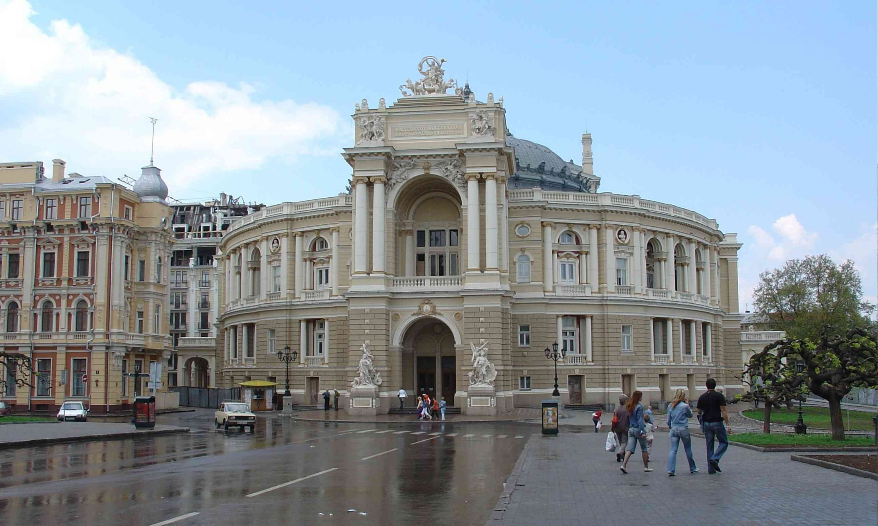
Λ polarization in peripheral heavy
ion collisions
New Trends in High-Energy Physics,
May 12-18, Odessa, Ukraine
Laszlo P. Csernai,
University of Bergen

Slide 2
Dr. Yilong Xie, U. Bergen, > CUG, Wuhan
Prof. Dujuan Wang, CCNU, Wuhan
Prof. V.K. Magas, U. Barcelona
Prof. D.D. Strottman, Los Alamos NL
Prof. J.I. Kapusta, U. Minnesota, Minneapolis

Slide 3
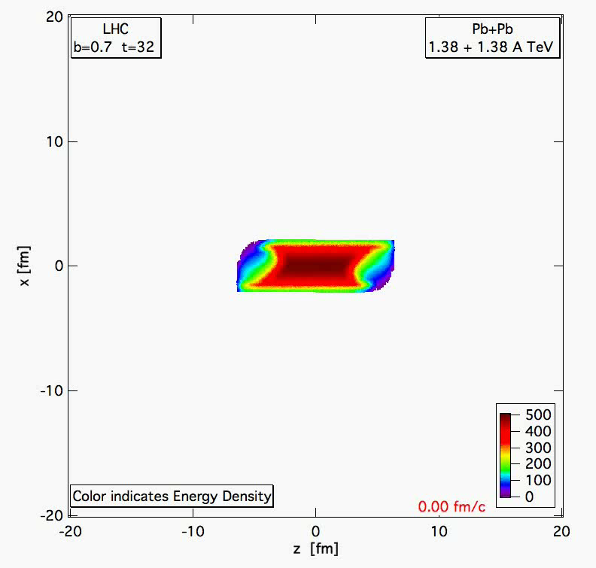
PIC-
hydro
Pb+Pb 1.38+1.38 A TeV, b= 70 % of b_max
Lagrangian fluid cells, moving, ~ 5 mill.
MIT Bag m. EoS
FO at T ~ 200 MeV, but calculated much longer, until pressure is zero for 90% of the cells.
Structure and asymmetries of init. state are maintained in nearly perfect expansion.

Slide 4
For a reconstructable series expansion we need a fixed coordinate system x, y, z, axes (reaction plane) and the c.m. – EbE.
Both global collective flow and fluctuations can be characterized in such reference frame.

Slide 5
Periheral Collisions - Initial State
Peripheral reactions
ⱻ Shear ➔ vorticity ➔
L: in -y direction
Hw P: L = ?

Slide 6
Initial State – Peripheral reactions
Magas, Csernai, Strottman (2001), (2002)
Yang-Mills flux tube model for longitudinal streaks
String tension is decreasing at the periphery
Initial shear & vorticity is present

Slide 7
Present parton kinetic models
- HIJING, AMPT, PACIAE
Different space-time configurations
[Long-Gang Pang, Hannah Petersen, Guang-You Qin, Victor Roy and Xin-Nian Wang, 27 September - 3 October
2015, Kobe, Japan; and Long-Gang Pang, Hannah Petersen, Guang-You Qin, Victor Roy, Xin-Nian Wang, arXiv: 1511.04131 ]
[Wei-Tian Deng, and Xu-Guang Huang, arXiv: 1609.01801, Phys. Rev. C 93, 064907 (2016)]

Slide 8
Present parton kinetic models
- HIJING, AMPT, PATHIA
Different space-time configurations
[Wei-Tian Deng, and Xu-Guang Huang,
Vorticity in heavy-ion collisions,
Phys. Rev. C 93, 064907 (2016).]
Max ω_{y} is at x=0 !!!
ε flow
ρ flow

Slide 9
New I.S. in τ, η coordinates ➔ x,y,z,t
Thus for each streak, i, we can get the origin of the τ=τ₀ hyperbola,
Energy density GeV/fm³
propagated to the c.m. hyperbola

Slide 10
Consequences – vorticity (2018):
Vorticity is max. at the edges, at high +/- X
Consequence of the Bjorken type model
Contradicts to AMPT and parton
cascade results of [Wei-Tian Deng, and
Xu-Guang Huang, arXiv: 1609.01801],
where max. is at x=0.

Slide 11
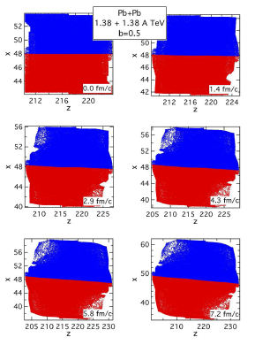
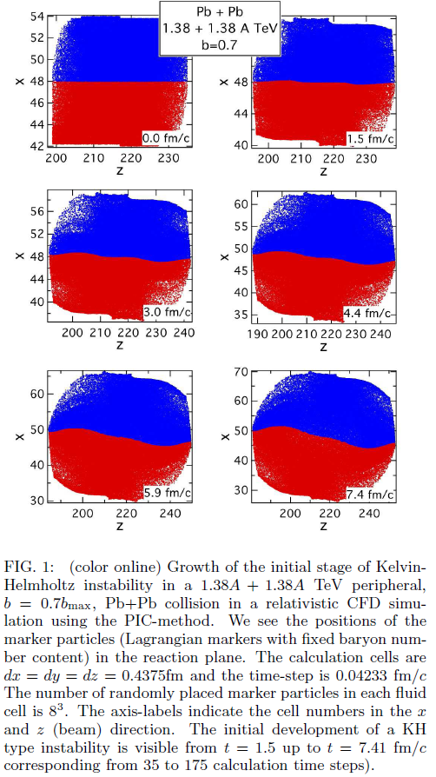
Shear & Turbulence → KHI
ROTATION – high η
KHI– low η
KHI
2.4 fm

Slide 12
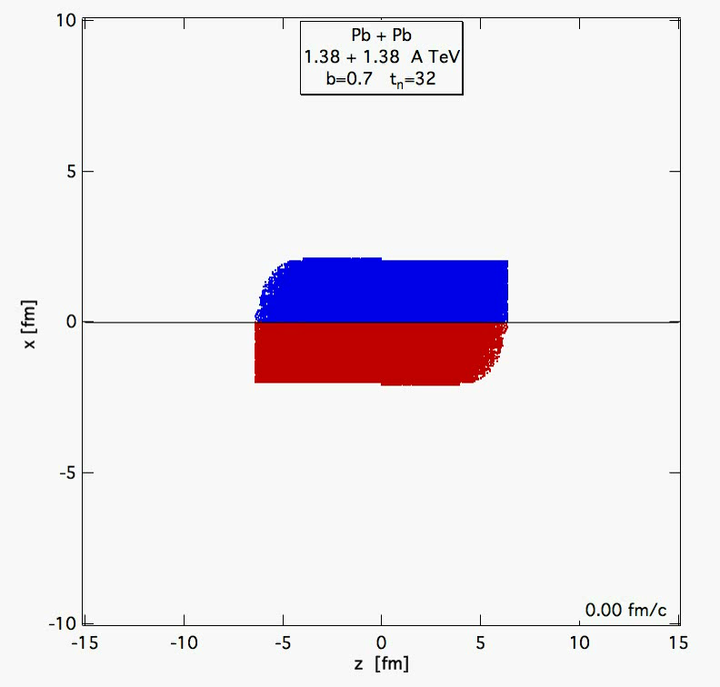
Kelvin –Helmholtz
Instability
PICR
Hydro
(2012)

Slide 13
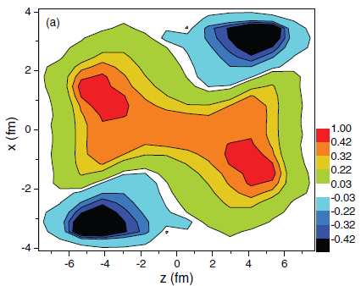
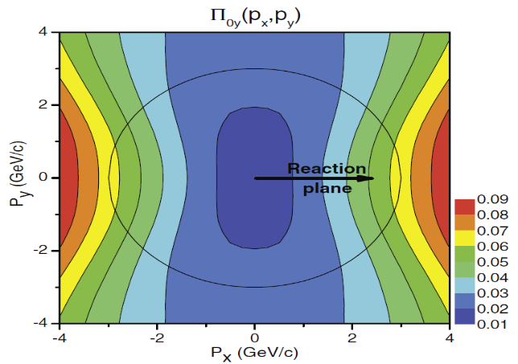
Consequences – vorticity (2013):
Will be similar to the 2001-2 I.S. in (t,z) coordinates
More compact → vorticity may survive better
The earlier results will remain qualitatively similar:
Fig. 3 The vorticity calculated in the reaction (xz) plane at t = 0.17 fm/c after the start of fluid dynamical evolution.
Fig. 4. The dominant y component of the observable polarization, Π₀(p) in the Λ’s rest frame.
The initial rotation can lead to observable vorticity (Fig. 3),
and polarization (Fig. 4): Leading vorticity term.
The initial angular momentum can be transferred to the polarization at final state, via spin-orbit coupling or equipartition.
[L. P. Csernai, et al, PRC 87, 034906 (2013) ]
[F. Becattini, et al. PRC 88, 034905 (2013) ]

Slide 14
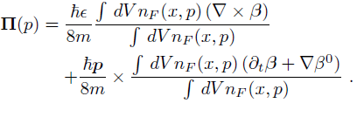


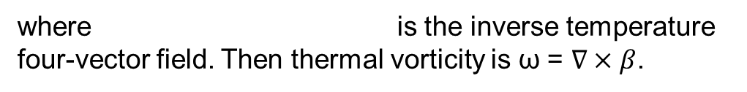
Consequences:
Based on Ref. [Becattini, 2013], Λ polarization can be calculated as:
Vorticity, 1st
Expansion, 2nd
where is the inverse temperature four-vector field. Then thermal vorticity is ω = $∇×β$.
The polarization 3-vector in the rest frame of particle can be found by Lorentz-boosting the above four-vector:
[F. Becattini, L.P. Csernai, and D.J. Wang, Phys. Rev. C 88, 034905 (2013) ]

Slide 15
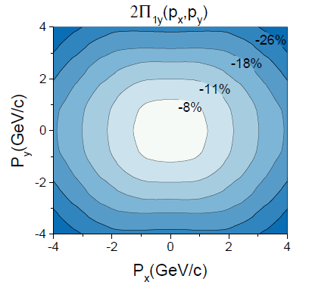
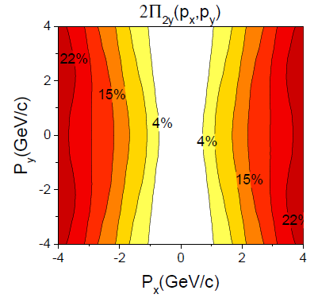
Consequences:
Fig. 6 The first (left) and second (right) term of the dominant y component of the Λ polarization for momentum vectors in the transverse plane at p_{z} = 0,for the FAIR U+U reaction at 8.0 GeV
The y component is dominant, is up to ~20%, as we can compare it with x and z components later.
1st & 2nd terms are opposite direction. Result into a relatively smaller value of global polarization.

Slide 16
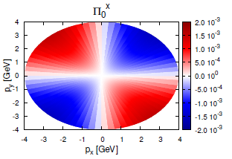
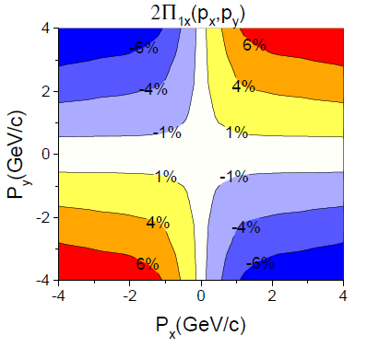
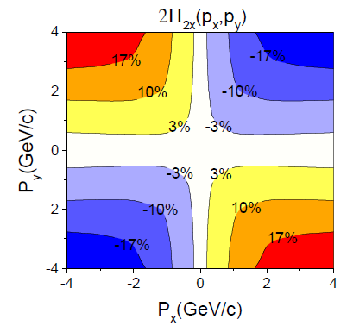
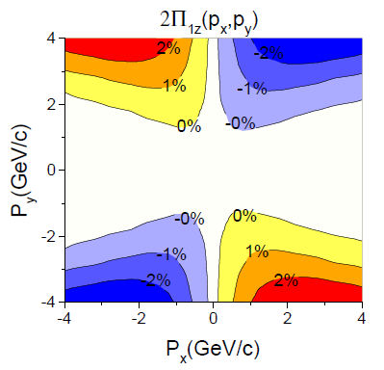
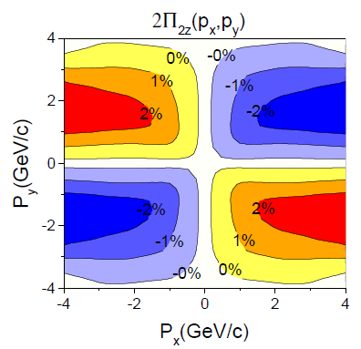
Consequences (2016) / c.m. !
[Becattini, et al.,
Eur. Phys. J. C
75, 406 (2015).]
Anti-symmetry
Fig. 7 The first (left) and second (right) terms of the x(up) and y(down) components of the Λ polarization for momentum vectors in the
transverse plane at pz = 0,for the FAIR U+U reaction at 8.0 GeV
[ Xie, Bleicher,
Stoecker, Wang, Csernai,
PRC 94, 054907 (2016). ]

Slide 17
At the highest energies / Rel. Hydro. (2018)
[ Xie et al., PRC
94, 054907 (2016)]

Slide 18
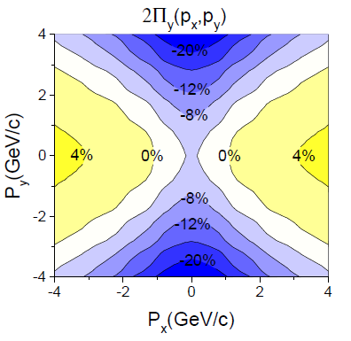
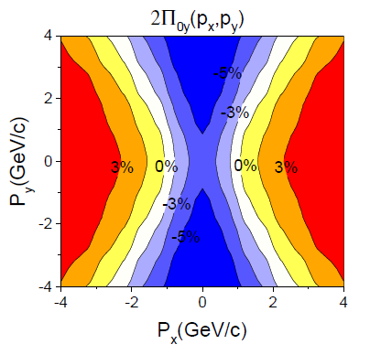
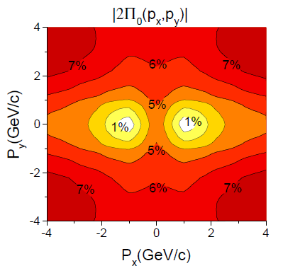
Consequences FAIR
The modulus of polarization is very similar with the y component of polarization, both in magnitude and the structure. I. e. the other x and z components do not contribute to the polarization, which is in line with previous observations in this work and other papers.
[ Xie et al., PRC
94, 054907 (2016)]
Fig. 8 The y component (left) of polarization vector in center of mass frame and Λ’s rest frame. The right sub-figure are the modulus of the polarization in Λ’s rest frame. At FAIR, 8.0 GeV at time 2.5+4.75 fm/c.

Slide 19
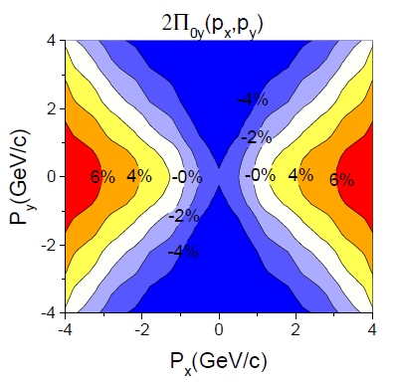
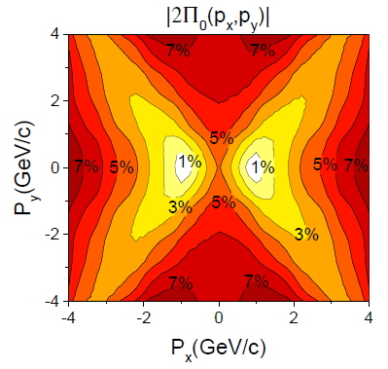
Consequences NICA
Fig. 9 The y component (left) and the modulus (right) of the polarization for momentum vectors in the transverse plane at pz = 0, for the NICA Au+Au reaction at 9.3 GeV. The figure is in the Λ’s rest frame.
[ Xie et al., PRC
94, 054907 (2016)]
Similarity between y component and modulus of Polarization, in magnitude and structure.
Similarity between NICA and FAIR’s polarization results.
The net polarization is still negative, which means the first term is larger than the second term, at this time.

Slide 20
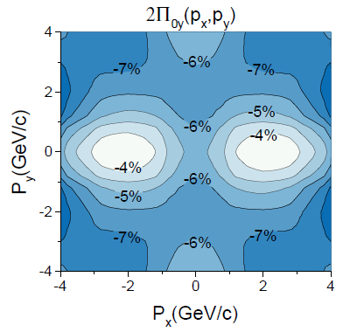
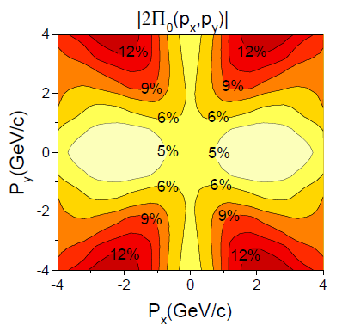
Consequences FAIR
[ Xie et al.,
PRC 94,
054907 (2016)]
Fig. 9 The y component (left) and the modulus (right) of the polarization for momentum vectors in the transverse plane at pz = 0, for the FAIR U+U reaction at 8.0 GeV, but at an earlier time t= 2.5+1.7 fm/c. The figure is in the Λ’s rest frame.
Initially, the first term is very dominant

Slide 21
Polarization and EbE c.m. determination
Earlier EbE c.m. determination ➔ increased V₁ by a factor of 2 [Cs.,E.,M., (2012)].
Now polarization in x and z directions is symmetric in EbE c.m. frame!!!
➔ integrated x & z polarizations vanish (except random fluct.)
➔ finding EbE c.m. is possible by
  Minimizing integrated Π_{x} & Π_{z}
  Maximizing integrated –Π_{y}

Slide 22
Observable consequences
[Yilong Xie, Dujuan Wang, and Laszlo P. Csernai1
PHYSICAL REVIEW C 95, 031901(R) (2017)]
-y
PICR
Hydro
x
Mike Lisa & STAR:
Angular mom.→
Vorticity (rot v)→
Λ & anti- Λ
polarization
z
[ Xie et al., PRC
94, 054907 (2016).]

Slide 23
Λ & Anti-Λ Polarization
[Li, Petersen, et al.,
NPA 967 (2017) 772.]
AMPT
AMPT
[DeXian Wei et al.,
arXiv: 1810.00151]
[Baznat, Sorin et al., PRC
97, 041902 (R) (2018).]
QGSM
AMPT
AMPT
[ Li, Pang et al.,
PRC 69, 054908 (2017).]
[Sun & Ko, PRC
96, 024906 (2017).]

Slide 24
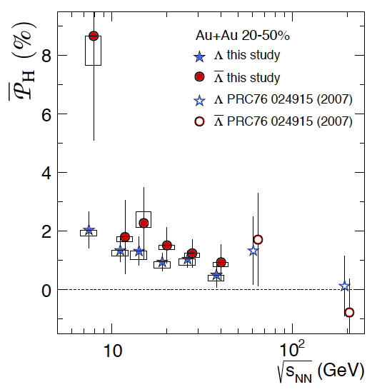
Global Λ Polarization
[Global Λ hyperon polarization
in nuclear collisions,
STAR Collaboration
Nature Letters -548, 62 (2017).]
Positive Λ signal → positive vorticity
First time non-zero signal observed!
Λ > Λ (?) → magnetic coupling
First measurement on ϕ meson spin alignment
arXiv:1701.06657

Slide 25
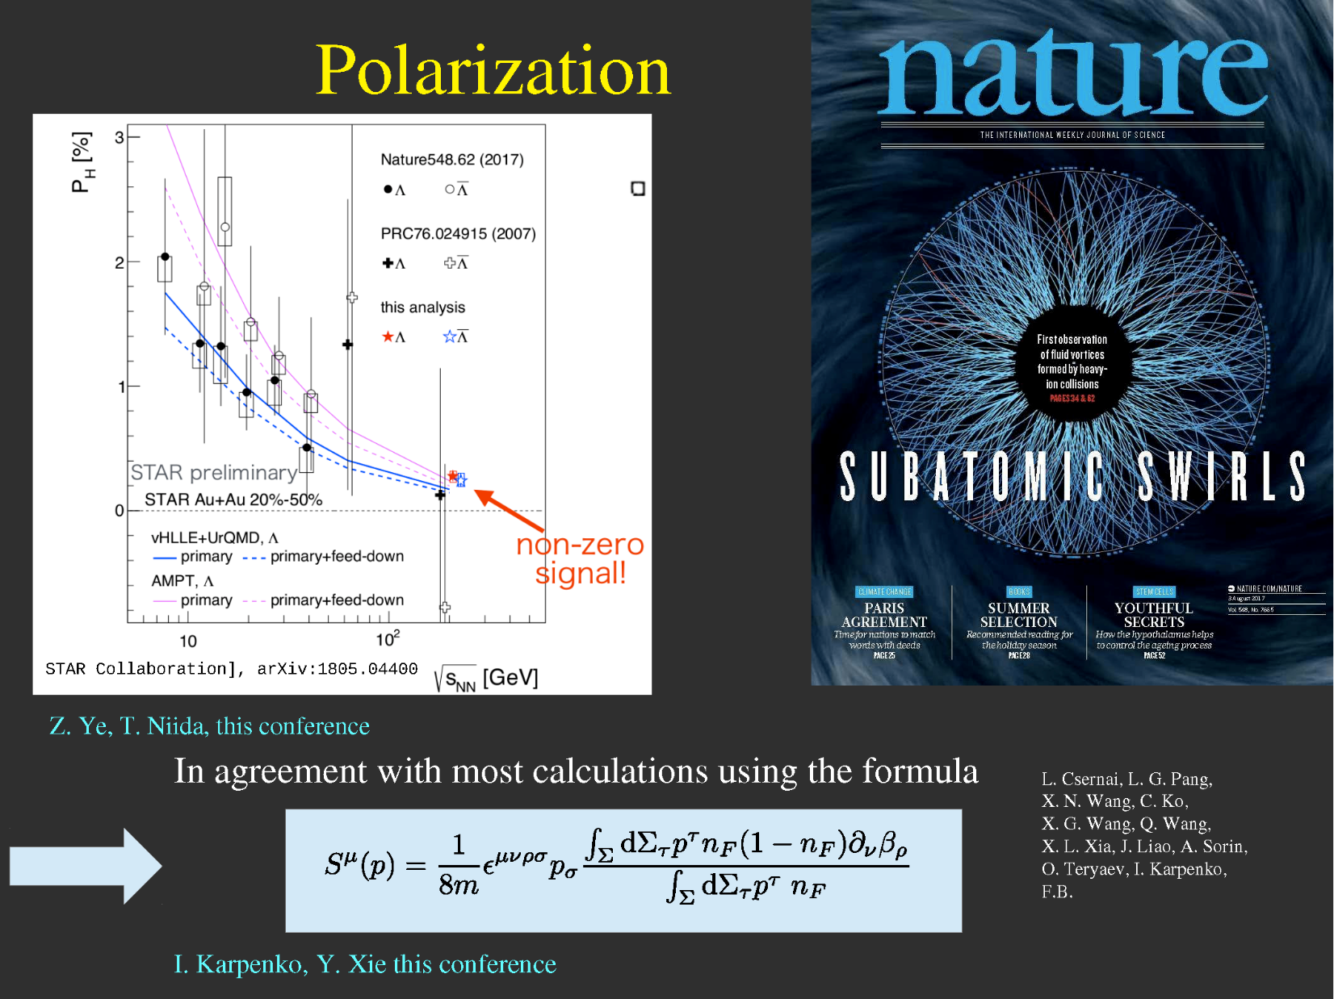
[ F. Becattini, QM18]
One of the most important new results in last year:
Global Λ hyperon polarization in nucl. coll., Nature, August 2017
Sensitive measure of angular momentum, collective shear & vorticity in peripheral heavy ion collisions!
P_{H} is defined positive, but points in the –y direction !

Slide 26
[ T. Niida, QM18]
P_{H} is defined
positive, but points in the –y direction !

Slide 27
Question # 1
Dependence of polarization on the emission angle of the Λ
P_{Λ} (p_{x},p_{y})

Slide 28
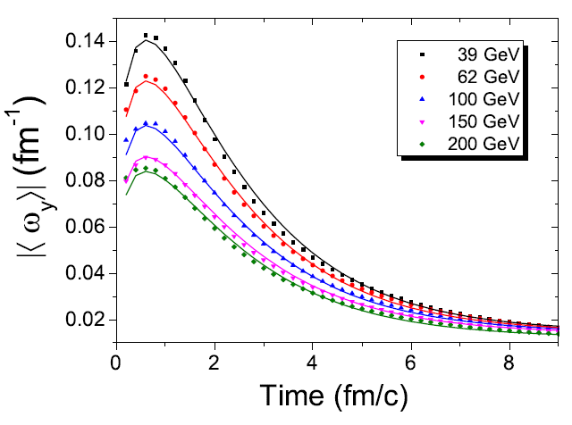
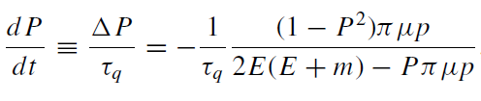
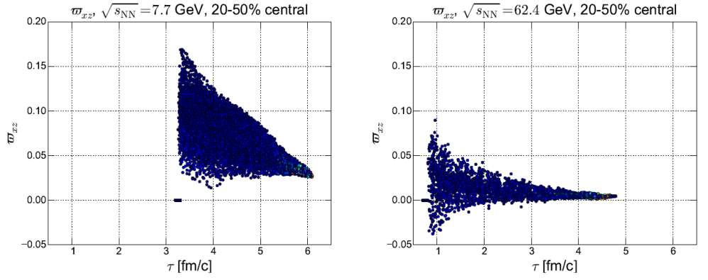
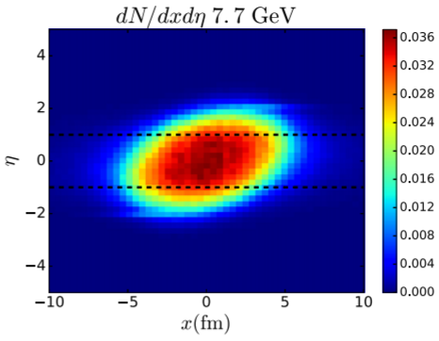
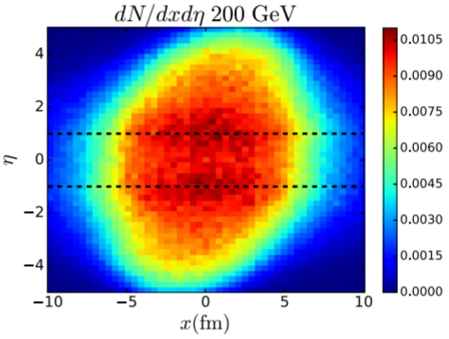



Puzzle 1: Energy dependence
Interpretations of the energy dependence behavior:
Drastic thermal motion of particles in
higher temperature/energy.
3. Initial State: tilted more for low energy, Larger ${\overline{ω}}_{xz}$
2. The vorticity decreases with the increased energy
4. Freeze out: Longer hydro evolution time for larger $√s$
Mean Free Path $∝$ Temperature
[ P. Huovinen, X.N. Wang et al., PRC 84,054910 (2011). ]
AMPT simulation for 39-200 GeV (b=7fm)
[Y. Jiang, et al., Phys. Rev. C 94, 044901 (2016).]
[ H. Li, L.G. Pang, et al., Phys. Rev. C 96, 054908 ]
[ I. Karpenko, F. Becattini, et al., Eur. Phys. J. C 77, 213 (2017). ]

Slide 29
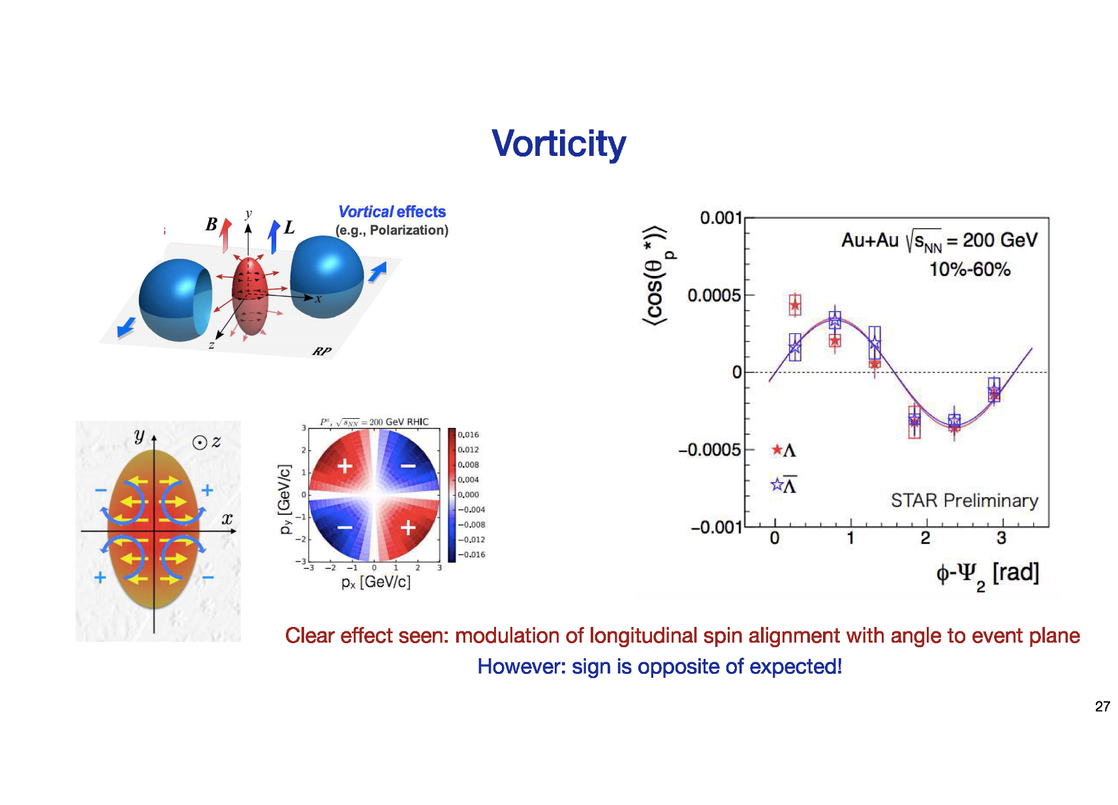
[ Marco van Leeuwen, Summary QM18]
General convention:
Projectile is at + X
Projectile moves twrd + Z
Here NOT !!!
2
???
Wrong !!!
a
P_{z}
0
π/2
1
P_{z}
0
π
π/2
[ STAR-arXiv-1805. 04400 & STAR- Zhenyu Ye, QM 18 ]
p_{x}
p_{y}=0
p_{y}
p_{x}=0
-p_{x}
π
P_{z}(p_{x},p_{y})
from elliptic flow vorticity
P_{z}(p_{x},p_{y})
no shear vorticity

Slide 30
Polarization vector
[ Yilong Xie, UoB, QM18]
Refs. [Becattini, 2008, 2013] revisited the relativistic thermodynamics with spin: adding a rotation term into the density operator for a rotating gas system in local equilibrium:
$$\hat{ρ}=\frac{1}{Z}exp[−\hat{H}/T+μ\hat{Q}+ω\hat{J}]$$
distribution function Spin tensor Pauli-Lubanski vector Polarization 4-vector
The Λpolarization (3-)vector in CM frame:
$$П\left(p\right)=\frac{ħε}{8m}\frac{\int{dV n_{F}\left(x,p\right)\left(∇×β\right)}}{\int{dV n_{F}\left(x,p\right)}}+\frac{ħp}{8m}×\frac{\int{dV n_{F}\left(x,p\right)\left(∂_{t}β+∇β^{0}\right)}}{\int{dV n_{F}\left(x,p\right)}}$$
1:Vorticity 2:Expansion
where is the inverse temperature four-vector field. Then thermal vorticity is ω= $∇×β$.
In experiments, the polarization is measured in particle’s rest frame---- Lorentz-boosting:
In experiments, the polarization is measured globally-----Integrating the y component of polarization Π_{0y}(p) over momentum space, to obtain the global polarization:
$$<П_{0y}>_{p}=\frac{\int{dpdxП_{0y}(p,x)n_{F}(x,p)}}{\int{dpdx n_{F}(x,p)}}=\frac{\int{dpП_{0y}(p)n_{F}(p)}}{\int{dp n_{F}(p)}}$$
[ F. Becattini, L.P. Csernai, and D.J. Wang, Phys. Rev. C 88, 034905 (2013). ]

Slide 31
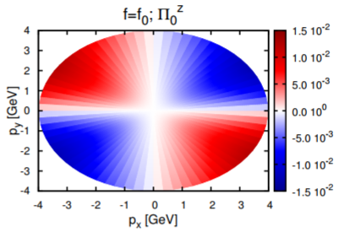
Results: X and Z components
[ Yilong Xie (U. Bergen) Quark Matter 2018
inv. talk.: Global Λ polarization … ]
P_{z} & P_{x} : no shear flow vorticity
1. Small magnitude.
2. Anti-symmetric
ECHO-QGP numerical code, implementing relativistic dissipative hydrodynamics
in the causal Israel-Stewart framework in 3+1 dimensions with an initial Bjorken flow profile
[Becattini, et al., Eur. Phys. J. C 75, 406 (2015).]
Fig. 7 The first (left) and second (right) terms of the x(up) and y(down) components of the Λ polarization for momentum vectors in the transverse plane at pz = 0,for the FAIR U+U reaction at 8.0 GeV
[DeXian Wei et al.,
arXiv: 1810.00151]
[Baznat, , Sorin, et al., PRC 97, 041902 (R) (2018).]

Slide 32
Conclusion # 1
[Yilong Xie,
talk QM18]
2: no shear
vorticity
[I. Karpenko,
talk QM18]
no initial shear
nο ΝR vorticity
* Signature in theory is in agreement !!! (Magnitude is I.S. dependent)
* Exp. is a mix of P-s for X & Y and 1 & 2 components

Slide 33
Question # 2
What causes the difference of
Λ and anti-Λ polarization ?

Slide 34
Λ & anti-Λ polarization measurement, BES:
STAR Collaboration, Nature 548, 62 (2017)
Indication of larger polarization of anti-Λ-s (?)
Frequently attributed to magnetic effect caused
the P & T spectators.
Summarized by [Karpenko, talk QM18]:
* Vorticity creates the average polarization.
* The magnetic moment makes the
Polarization splitting for Λ and anti-Λ
* Question is there magnetic field at
hadronization & freeze-out (??)
- Spectators are Lorentz contracted to Δt = 2R_{N}/γ
[STAR, Nature 548 (2017) 62.]

Slide 35
Frequently cited (!!!) :
The magnetic field lifetime in a collision
There is an internal current, j_{int}, generated in the medium.
"The characteristic time scale is defined by the external magnetic field and proportional to the thickness of the nucleus in the beam direction, i.e. tc~2R/ γ.For the top RHIC energy, tc ~ 0.2 fm/c.“
"These subtle [expansion] effects, however, cannot be taken into account in the present studies ... “
"The conducting medium in the collision is not formed immediately, because the quarks need time to be created from the glasma field. Nonetheless, to make our estimates of the conductivity effects as optimistic as possible we will consider that the conducting medium is formed immediately after the collision and does not alter (!) during the evolution."
Magnetic field for STATIC medium with Ohmic
conductivity.

Slide 36
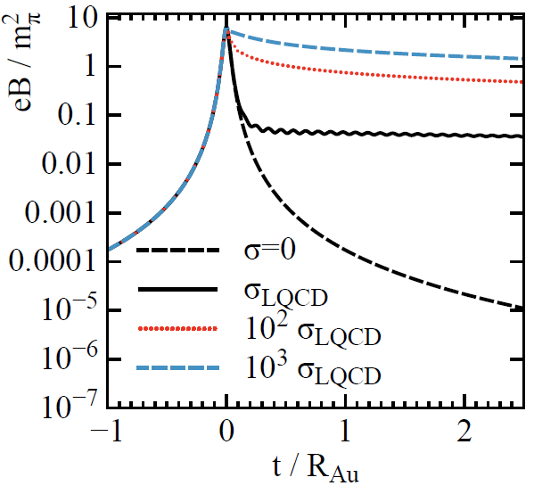
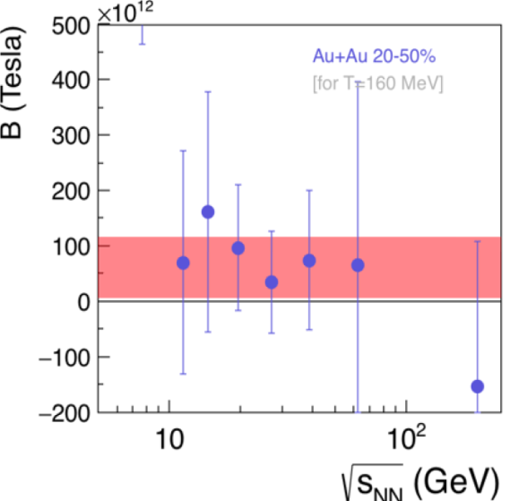
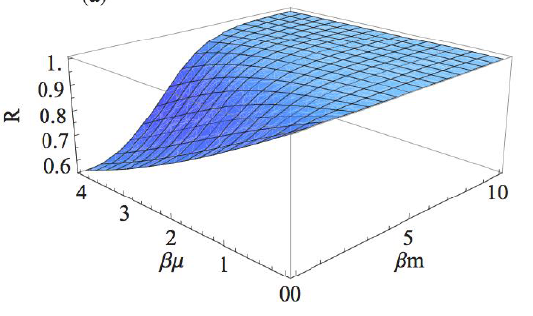
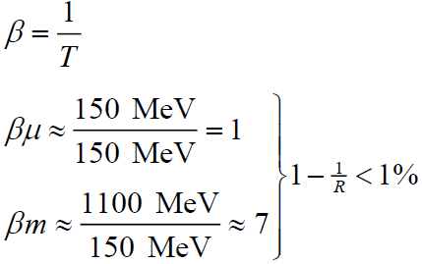
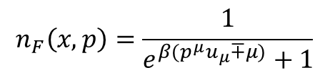

Polarization Splitting
Why is the Λ polarization larger than anti-Λ’s polarization, in RHIC BES program?
1. Polarization induced by magnetic field might split the vorticity induced polarization?
2. Effect of baryon chemical potential : accounts for only 1%
3. Axial Anomaly Charge: The same for Λs and anti-Λs. But $N_{Λ}>N_{\overline{Λ}}$
m_{π}²/e ≈10¹⁴T
[ L. McLerran, V. Skokov, Nucl.Phys. A929 (2014) 184-190 ]
[ M.A. Lisa, invited talk in Zimanyi School, Budapest 2017 ]
$$n_{F}\left(x,p\right)=\frac{1}{e^{β(p^{μ}u_{μ}∓μ)}+1}$$
R.H. Fang, et al., PRC 94 (2016) 024904;
M.A. Lisa, invited talk in WPCF, Budapest 2017
A. Sorin, O. Teryaev, PRC 94 011902(R) (2017)

Slide 37
The magnetic field lifetime in a collision 2
The magnetic field in the expanding medium is short lived, t ~ 0.15 fm/c at the initial moments, where quarks are not yet created.
The effect of this initial field is utterly negligible at the freeze out time of
t_{FO} ~ 10 fm/c.
Dynamical hydro calculations assume that thermal, spin, and vorticity are equilibrated by the FO time. The spin-orbit interaction is assumed to be sufficiently strong (and equal) to achieve this equilibrium.
[ V. Voronyuk, V. D. Toneev, W. Cassing, E. L. Bratkovskaya, V. P. Konchakovski, S. A. Voloshin ]

Slide 38
Competing strong spin-orbit interaction ⬅➔ Hypernuclei
In all calculations spin-orbit equilibration is assumed, by freeze-out
However, from initial vorticity it takes time to build up Λ polarization
Spin-orbit interaction for Λ and anti-Λ is not the same
This is indicated by spin-orbit splitting of Hypernuclei !
Presented also at Workshop on Chirality, Vorticity …,Firenze, 19-22 March & QM2018, Lido di Venezia, 14-19 May, 2018 :
  L.P. Csernai, Uo Bergen: Λ polarization in peripheral heavy ion collisions
  I. Vassiliev for the FAIR/CBM Collaboration: Perspectives on strangeness physics with CBM experiment
  Tetyana Galatyuk, TU Darmstadt / GSI: Future facilities for high μ_{B} physics
  Stefania Bufalino, Politecnico and INFN Torino: Strangeness and nuclei production in nuclear collisions

Slide 39
Λ & Anti-Λ Coupling to Nucleons
Difference based on Hypernuclei:
1.0 – 1.5 MeV i.e. ~ 20% of nuclear
binding energy !!!
ⱻ ~ 20 Λ-hypernuclei (Τ_{1/2} = 10⁻¹⁰s) 1953-1995
[ZhouSG-etal-PhysRevLett.91(2003)262501]
[ Csernai, Chirality WS, 2018 ]
[SongCY-etal-IJMPE19(2010)2538]

Slide 40
[ Vassiliev, QM 2018 ]

Slide 41
[ Stefania Bufalino, QM 2018 ]

Slide 42
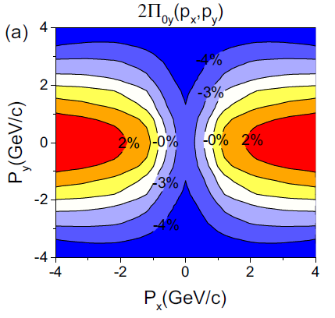
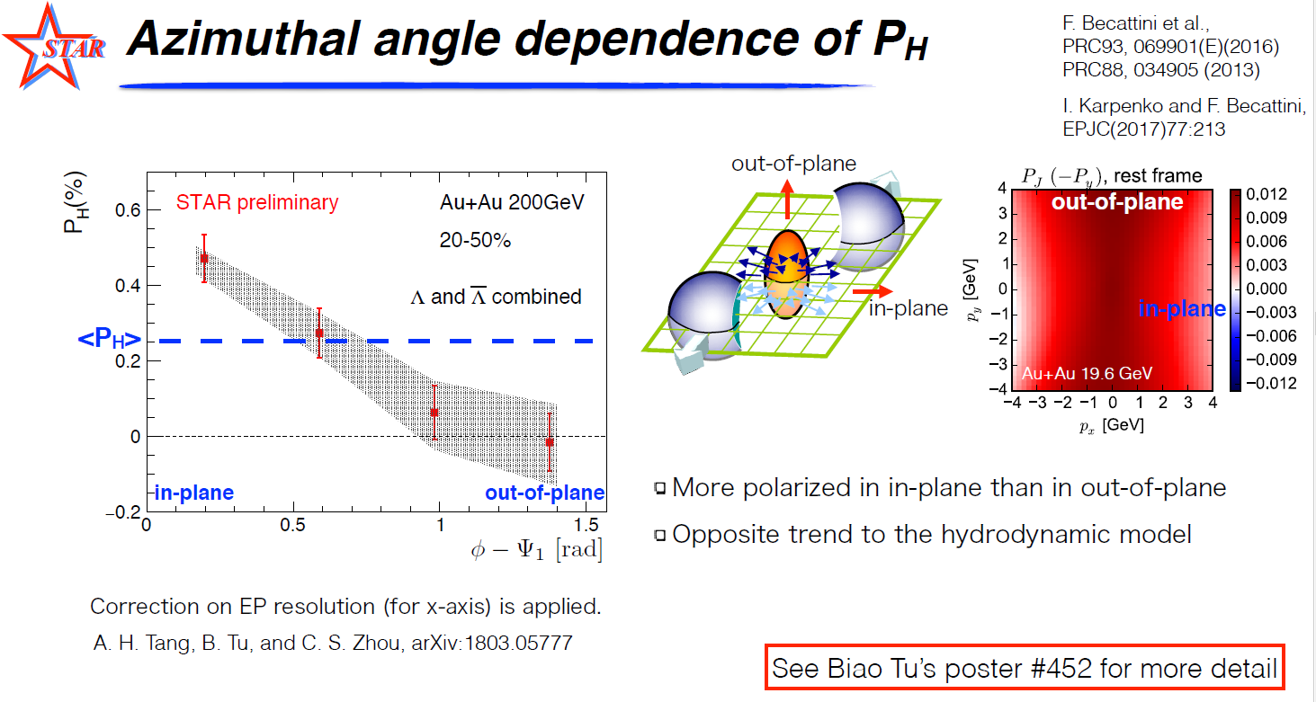
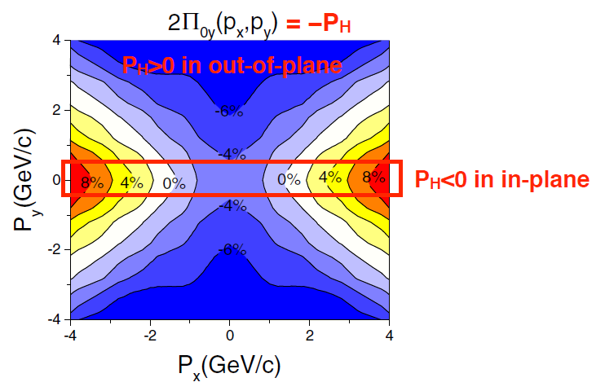
Puzzle 3：Sign Disagreement
Au-Au 11.5GeV
[ Y.L. Xie et al., PRC 93, 031901(R) (2017)]
Au-Au 200GeV
[Becattini, Y.L. Xie et.al, PRC93, 069901(E)(2016)]

Slide 43
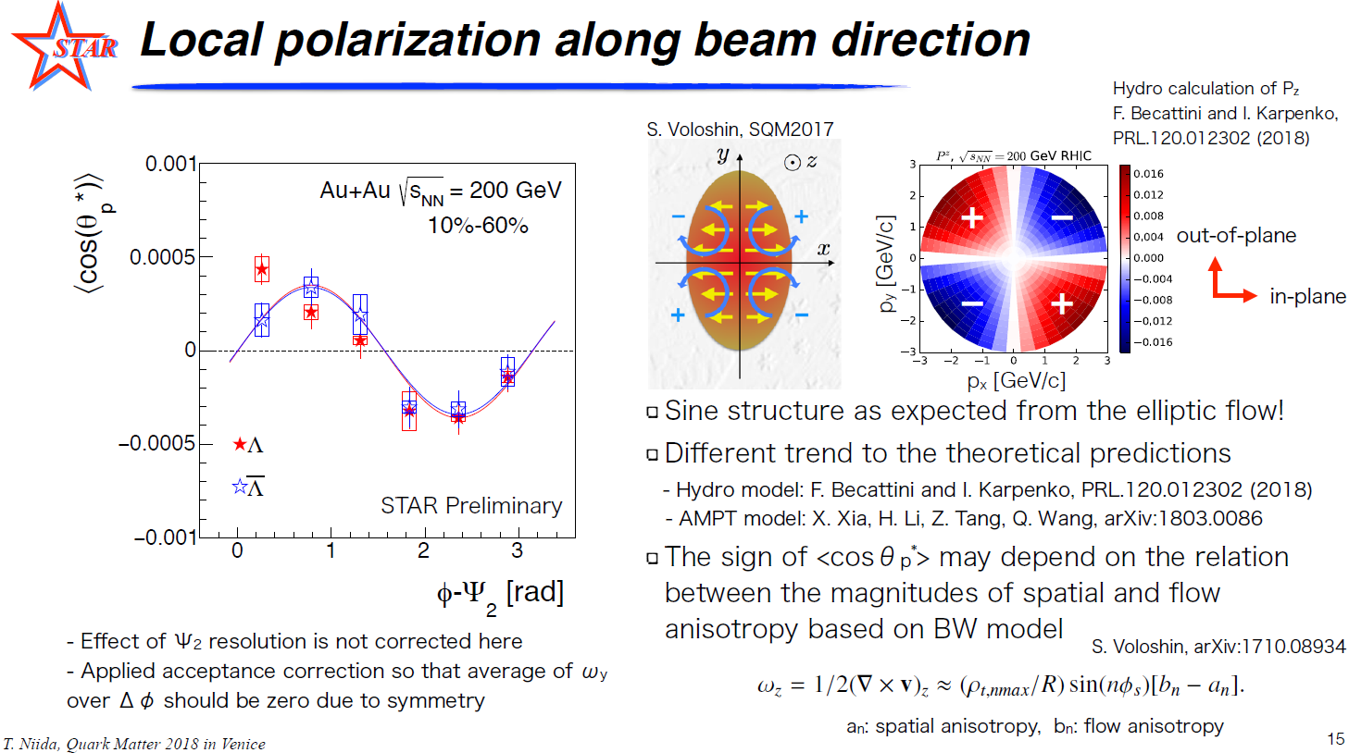
Puzzle 3：Sign disagreement

Slide 44
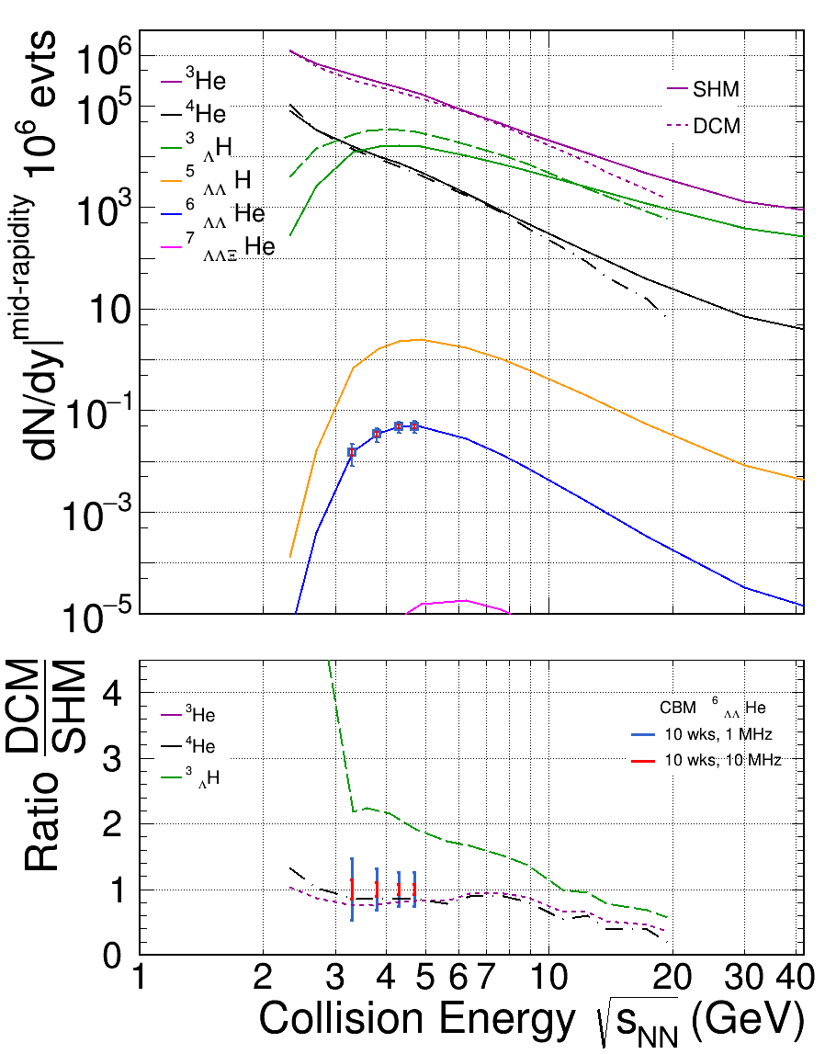
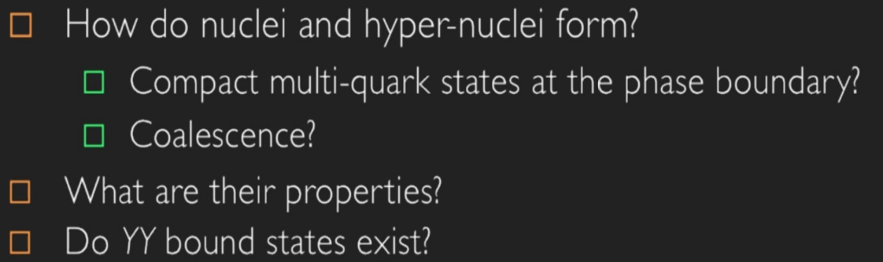

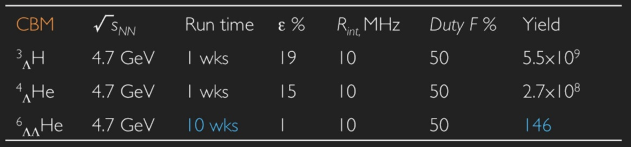
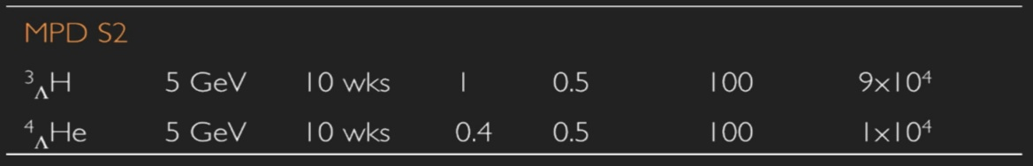


Precision measurement of spectra, life-time and flow pattern
CBM | √s_{NN} | Run time | ε % | R_{int,} MHz | Duty F % | Yield
³_{Λ}H | 4.7 GeV | 1 wks | 19 | 10 | 50 | 5.5x10⁹
⁴_{Λ}He | 4.7 GeV | 1 wks | 15 | 10 | 50 | 2.7x10⁸
⁶_{ΛΛ}He | 4.7 GeV | 10 wks | 1 | 10 | 50 | 146
MPD S2
³_{Λ}H | 5 GeV | 10 wks | 1 | 0.5 | 100 | 9x10⁴
⁴_{Λ}He | 5 GeV | 10 wks | 0.4 | 0.5 | 100 | 1x10⁴
[ Tetyana Galatyuk, QM 2018 ]

Slide 45
[ Stefania Bufalino, QM 2018 ]

Slide 46
Λ spin interaction with ω v.m. field
where is the usual Dirac 4x4 matrix.
[J. D. Bjorken and S. D. Drell, Relativistic Quantum Mechanics (McGraw-Hill, 1964)]
When acting on the spinors of Λ and anti-Λ they result in opposite signs whereas the second and third terms have the same sign.
The second and third terms contribute to the usual nuclear spin-orbit energy.
[ L. P. Csernai, J. I. Kapusta, T. Welle, PRC 99, 021901(R) (2019)]

Slide 47
Standard spin-orbit interaction
[ Serot & Walecka ]
➔
➔

Slide 48
If local thermal equilibration is assumed then no different spin/polarization
occurs for particles and antiparticles. The observed difference can be due to other effects, e.g. external magnetic field.

Slide 49
Energy dependence study of directed flow in Au+Au collisions
using an improved coalescence in AMPT model
Kishora Nayak,1 Shusu Shi,1, and Nu Xu1,2
v1 in the RHIC BES program
energy range is varying strongly, and different for particles with quarks created in the collision.
Thus estimates based on v1
are problematic, and depend on the spin polarization’s timescale.

Slide 50
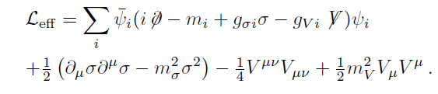
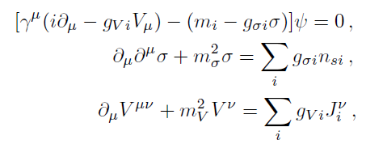
Vortical fermion system in bosonic field
Considering the system during hadron rescattering，the strong interactions between Λ and baryons are mediated by the scalar meson σ and vector meson V^{μ}
Euler-Lagrangan equation
Dirac equation with Yuwaka interaction
Klein-Gordon field (for massive spin-0 bosons)
Proca equation (for massive spin-1 bosons )
[L.P. Csernai, J. Kapusta, et al, PRC 99, 021901(R) (2019)]

Slide 51






Vortical fermion system in bosonic field
1. Dirac equations with Yuwaka interaction
------ FW (Foldy-Wouthuysen) Hamiltonian
Dirac 4 × 4 matrix:
2. KG equations
Analytic solution:
Simple Solution：
m_{V}=783MeV
m_{σ}=550MeV
3. Proca equations
Simple
Solution:

Slide 52




Vortical fermion system in bosonic field
In conclusion, the baryons (fermions) with vorticity will induce vector meson (bosons) magnetic field, this magnetic&electric field would interact with the Λ’s spin, resulting into the polarization and polarization difference between Λ and anti- Λ.
[L.P. Csernai, J. Kapusta, et al,
PRC 99, 021901(R) (2019)]

Slide 53





Puzzle 3：Spatial and Temporal components of vorticity
Au-Au, 200GeV
Au-Au 200GeV, Freeze-Out time: 2.5+ 4.75fm/c
FAIR 8GeV
Use the same date in [ Y.L. Xie et al., PRC 93, 031901(R) (2017)]
Same sign distribution??

Slide 54


Spatial and Temporal components of vorticity
In our model, the second term plays crucial role to obtain correct structure of local longitudinal polarization and magnitude of global polarizations.
[E. E. Kolomeitsev, et al,
PRC 97, 064902 (2018)]
[W. Florkowski, et al,
arxiv:1904.00002]

Slide 55





Outlook: Polarization as probe for initial fluctuations
Applying the approach of [Csernai, Kapusta, PRC 99, 021901(R) (2019)], to the QGP phase:
with gluon tensor:
In the weak coupling limits, we neglect the gluon’s self energy term. Then this is an Abelian plasma, with color electric&magnetic field obeying the Maxwell equations:
(with local equilibrium)

Slide 56



Outlook: Polarization as probe for initial fluctuations
Classical FW transformation is not necessarily valid for relativistic strange quarks in such high energy and temperature. So we use the generalized FW transformation for the relativistic particles with any spin, proposed by [A. J. Silenko, PRA 77, 012116 (2008)] :
The main problem in this approach is that: the Event-Average net color charge in QGP is zero, as well as the color current. Therefore this type of polarization induced by color magnetic field is based on the initial color fluctuation. If this is true, then we expect to observe this EbE polarization in high energy collisions beyond RHIC’s 200GeV:
1) the event-averaged global Λ polarization were expected to be consistent with zero.
2) while the color fluctuations, which depends on the Bjorken variable x, are expected to be large.

Slide 57






Outlook: Polarization as probe for initial fluctuations
If we keep the order to 4th order flow $v_{4}$ , then an correction term will show up:
$\frac{dT}{dτ}\frac{1}{mT}[v_{2}\left(p_{T}\right)sin2φ+\left(2v_{4}−v_{2}^{2}\right)sin4φ]$
Ratio $v_{4}/v_{2}^{2}$ is related to eccentricity fluctuation, and equals to 0.5 when without fluctuations.

Slide 58
Summary
Collective flow is the most dominant collective feature of HI reactions.
Peripheral reactions show shear, vorticity (turbulence) for small transport coefficients ➔ exp. Λ-Polarization
I.S. is of utmost importance, it can be implemented
in (t, z) and ( τ, η) hydro codes
Different components, -y, x, z, and momentum dependence do show the weight of different dynamical flow patterns.
➔ Λ-Polarization is highly sensitive diagnostic tool
_{--- * ---}

